Slide 1




Teacher notes: Year 9 – Know your KS4 options
This lesson aims to support students to:
Develop their career skills for life, learning and work
Prepare for the next career decisions they will have to make
Career development skills (CDI Framework)
Preparing for choosing their GCSEs
Being aware of the main learning pathways (e.g. university, college and apprenticeships)
Being aware that many jobs require learning, skills and minimum qualifications
A one-hour careers lesson to help Year 9 students (or Year 8, depending on when your school runs options) prepare to choose their GCSEs.
Online version
Students need a computer, tablet or phone
Gatsby Benchmarks
Equalex Framework
Skills Builder
1, 2, 3, 4 and 6
Introduce & Inspire
Investigate & Explore
Notes:
These lessons have been developed to support students to build their career development skills, as identified by the CDI Career Development Framework. Each lesson identifies outcomes linked to the CDI framework.
The lessons support meeting Gatsby Benchmarks 1, 2, 3, 4 and 6 and the Equalex Framework for preparing students for Modern Work Experience, as they 'Introduce & Inspire' students about the world of work and 'Investigate & Explore' jobs and careers.
The lessons give students opportunities to practise their essential skills, as identified in the Skills Builder Universal Framework 2.0: www.skillsbuilder.org/universal-framework
The relevant skills steps are identified in the teacher notes for each activity, with reflection questions and prompts for discussion as part of the plenary.
Use this lesson with the year group that is about to choose its Key Stage 4 options (Year 8 or Year 9, depending on your school).
This is the ONLINE version: students need a computer, tablet or phone with internet access for Task 2. Print the My Subjects sheet (slide 14) and the Task 2 task list (slide 15). Check with your school or Trust IT team that nextstepsready.org.uk is not blocked.

Slide 2

Lesson overview
Before the lesson: print the My Subjects sheet (slide 14) and task list (slide 15), and have your school's list of KS4 subjects ready. Students need a device – check nextstepsready.org.uk opens in school.
Timing | Slides | Activity | Resources
10 mins | 4–8 | Introduction: qualifications ladder, GCSE subjects for jobs (3 mins), key points about KS4 options | BBC Bitesize video (optional)
10 mins | 9 | Task 1: explore KS4 qualifications and choose your top 8 subjects | My Subjects sheet, school subject list
20 mins | 10–11 | Task 2: research where your favourite subject could lead on nextstepsready.org.uk | Devices, task list
10 mins | 12–13 | Share your research, then wrap-up | Task lists
Total: about 50 minutes. Timings are a guide – the research task can be extended.
Notes:
Use this overview to plan the lesson. The timings match the timers on the task slides.

Slide 3




In this lesson you will:
Find out about the main learning pathways: university, college and apprenticeships.
1
Understand that many jobs need learning, skills and qualifications.
2
Careers lesson
Know your KS4 options
Start preparing to choose your GCSE options.
3
Find out about qualifications and start thinking about your GCSE choices.
Introduction
10 mins
Activities
30 mins
Sharing
10 mins
Notes:
This slide shows students what they will do in the lesson and how long each part takes.
The Career Development Institute has developed a careers framework that shows the skills everybody needs to manage their future career. These aims link to the CDI career learning areas.

Slide 4



Careers, jobs and qualifications
A career is an individual's journey through life, learning and work.
A job is work that a person does regularly to earn money and help provide a service, make something, or support other people.
Many jobs need specific qualifications and skills.
It is all about YOU!
Do you have any idea what sort of job you might like to do one day?
Notes:
Ask students if they know what a career means.
Encourage students to explain what is meant by the words career and job, then reveal the answers.
Explain that many jobs require you to have specific learning, skills and qualifications.
Ask students to share if they have any idea about what sort of job or work they might like to do one day.

Slide 5
What are qualifications?
Qualifications go up in levels. There are three main pathways – and you can move between them.
Academic
Technical & vocational
Apprenticeships
Level 6
Degree achieved
GCSEs are the first step on the ladder – and you will soon be choosing yours.
Level 5
Degree Year 2
HND / Foundation Degree Year 2
Higher Apprenticeship
Level 4
Degree Year 1
HNC / Foundation Degree Year 1
Higher Apprenticeship
Level 3
A levels
BTEC / OCR or T Level, V Levels (Level 3)
Advanced Apprenticeship
See every level, up to Level 8:
Tools › Qualification Ladder on nextstepsready.org.uk
Level 2
5 GCSEs at grades 4–9
Level 2 vocational qualification
Intermediate Apprenticeship
Level 1
GCSEs at grades 1–3
Notes:
Explain that there are three main pathways – academic, technical and vocational, and apprenticeships – and that qualifications go up in levels, from Entry Level up to Level 8. Students can move between the pathways.
There are different types of qualifications, but students will soon be choosing their GCSEs, which are the first stage of the qualifications ladder (Levels 1 and 2, highlighted).
The Qualification Ladder in the Tools section of Next Steps Ready shows every level, up to Level 8.

Slide 6




Which GCSE subjects would help?
Dentist
Nurse
Architect
Outdoor activities instructor
In pairs: which subjects would be useful for these jobs?
3 mins
Notes:
In pairs, ask students to think of the school subjects that would be useful for one or two of these jobs.
Suggested answers:
Dentist – science, design and technology
Nurse – science, English, maths
Architect – maths, physics, art
Outdoor activities instructor – PE, geography

Slide 7



Key points about Key Stage 4 options
Watch a BBC Bitesize video on choosing your GCSE options
While you watch: what is one thing you didn't know about choosing your options?
www.bbc.co.uk/bitesize/articles/zrjh92p
Notes:
Watch a video on choosing your GCSE options:
https://www.bbc.co.uk/bitesize/articles/zrjh92p
Open this link to view the video in a separate tab.
Afterwards, ask students to share one thing they didn't know about choosing their options.

Slide 8



Things to consider when choosing subjects
Science or engineering?
Working abroad or travel?
Sixth form or college?
If you want a job or career in science or engineering, choose double or triple science.
If you want a job working abroad, or you would like to travel, a language is really useful.
If you want to study a subject in sixth form or college, don't drop it in Year 10. For example, if you want to do A level Art, don't drop Art at GCSE.
Most GCSEs are general – not choosing one rarely closes down your options.
Notes:
Explain that because GCSEs are general qualifications, not choosing one doesn't close down your options – but there are a few things to bear in mind.

Slide 9

Task 1: Explore KS4 qualifications
GCSEs
Vocational courses
Task
Can you name the GCSE subjects your school offers?
Which subjects do you have to study?
Does your school offer other courses – qualifications related to a job area?
Using your school's list, write down YOUR top 8 subjects.
Circle your favourite subject.
This is not your final choice
You can change your mind! Check your school's options booklet, the date you need to choose by, and any options evening.
10 mins
Notes:
As a whole group, see if students can name the subjects they can study for GCSE at your school.
See if they know of any vocational courses on offer (help them if they don't).
Use your school's website or options booklet to explore the subject options at your school. Remind students when they need to choose their subjects by, and if there is an options evening.
Which subjects are compulsory? Circle them – for example English, maths and science.
Students write down 8 subjects they are interested in on the My Subjects sheet (slide 14) and circle their favourite subject. You might do a quick hands-up poll for the class's favourite subject.

Slide 10
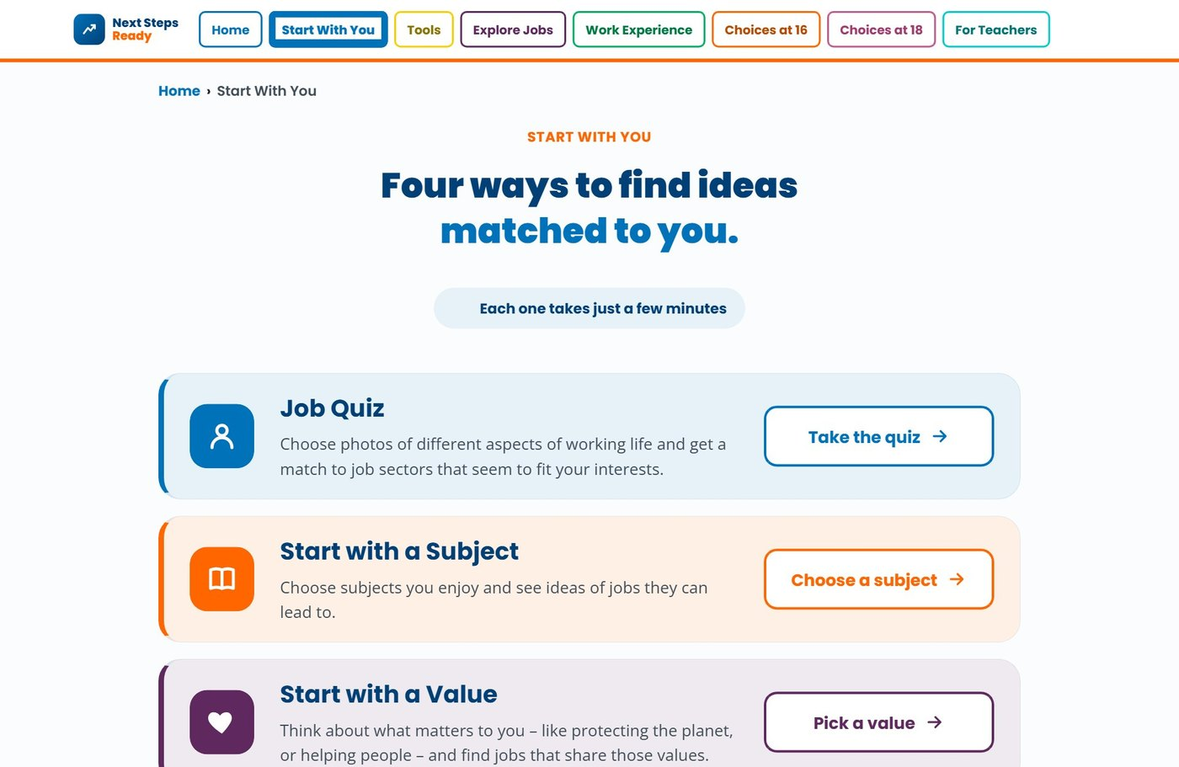

A website to help with your future career
nextstepsready.org.uk
Free for everyone
No login or password
Works on computers, tablets and phones
Notes:
Introduce Next Steps Ready: a free careers website with quizzes, tools and job information. There is no login, so students can use it in school and at home.
Today students will use Start with a Subject, in the Start With You section (circled).

Slide 11
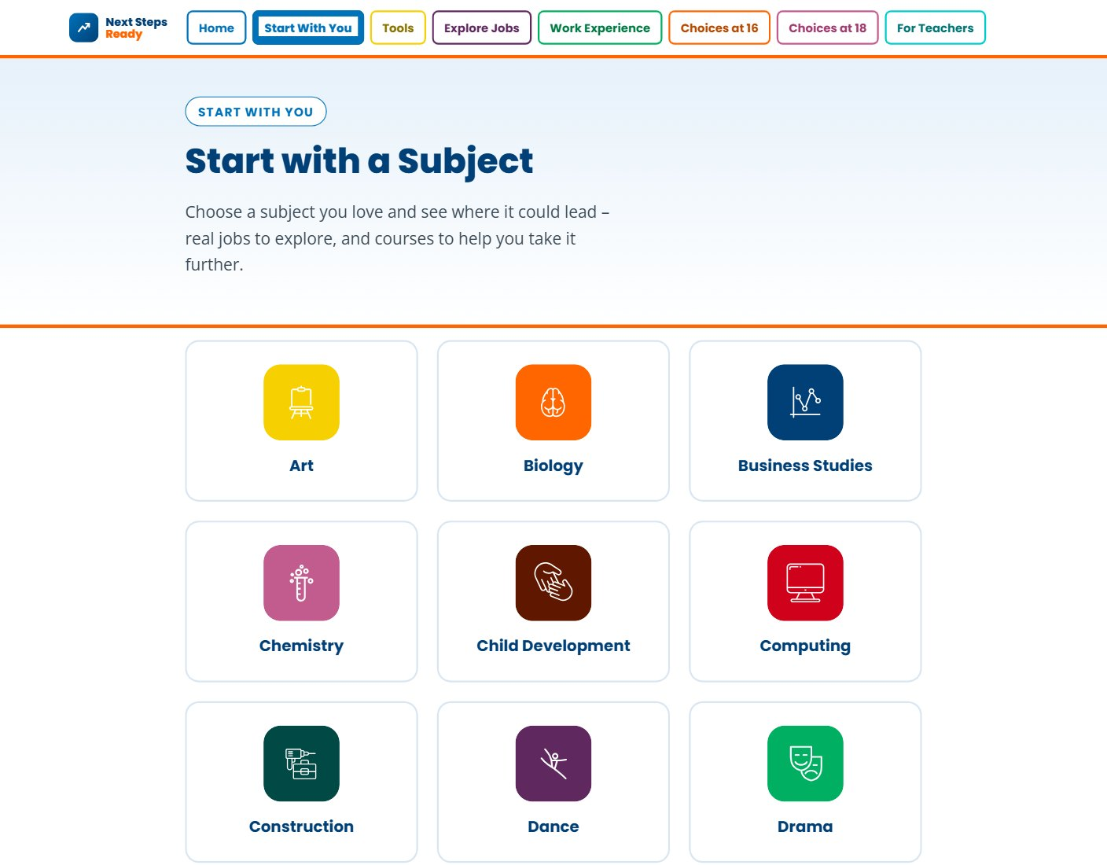
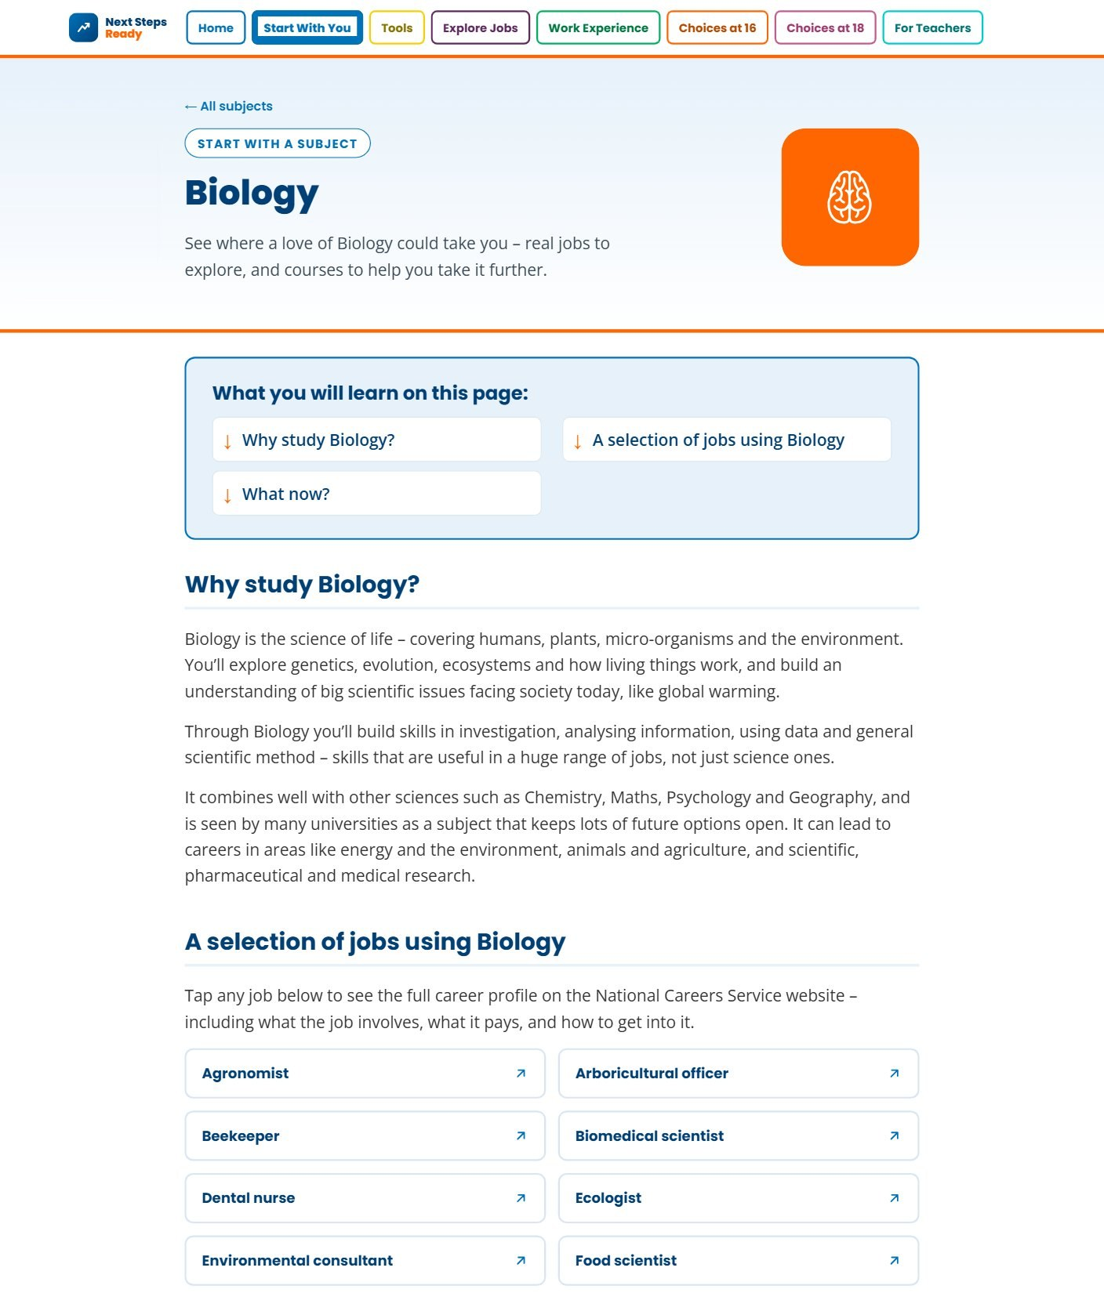

Task 2: Where could your subject lead?
1
In Start with a Subject, click your favourite subject
2
Read why to study it, and look at the jobs it leads to
3
Explore one or two jobs
Research:
What salary might you get?
Which pathways can you take into the job, name 2
What skills might you need, name 2.
Tap any job to see its full profile on the National Careers Service.
20 mins
Notes:
Students go to nextstepsready.org.uk, choose Start With You, then Start with a Subject. They click their favourite subject from Task 1.
Each subject page explains why to study the subject and lists a selection of jobs that use it. Tapping a job opens its full career profile on the National Careers Service.
Students tick off each step on their task list (slide 15) and record what they find for one job: the salary, two pathways into the job and two skills it needs. Faster students can explore a second job. They will use their task list to share with a partner in the next activity.

Slide 12
Sharing with others
10 mins
Take it in turns to share what you found: why you chose the subject, why it is a good GCSE choice, and a job it could lead to – its salary, pathways and skills.
Speak clearly and use your task list to support your points. Remember – you are selling your subject!
Listen carefully while your partner speaks, and think about how they use their tone to persuade you.
Notes:
Students share their research in pairs or with the class, using their task lists. They can show the job profile on screen as they talk.
This activity supports developing Speaking and Listening skills at the following steps in the Skills Builder Framework:
Speaking Step 9 – Sharing visuals: I use images, charts or diagrams when it helps my communication
Listening Step 10 – Recognising tone: I recognise the tone of communication
Ask students for feedback on how they or their partner showed these skills steps.

Slide 13


In this lesson you:
Found out about the main learning pathways and qualification levels.
Thought about which subjects are useful for different jobs.
Started preparing to choose your GCSE options.
Explore more subjects at home: nextstepsready.org.uk › Start With You
Notes:
Recap the lesson with the class. Ask: has anyone changed their mind about a subject today? Which jobs surprised you?
Remind students to talk to family, teachers and your careers adviser before choosing, and that they can use Next Steps Ready at home – it is free and there is no login.

Slide 14
My Subjects
Name: ……………………………………………………………
My top 8 subjects – circle your favourite
Subjects I have to study:
1
2
3
4
5
6
7
8
……………………………………………
……………………………………………
……………………………………………
Options deadline / options evening:
……………………………………………
My favourite subject: ………………………… I like it because ……………………………………………………… It could lead to jobs like ………………………………
Notes:
Printable sheet for Task 1 (the favourite subject box leads into Task 2). Print one copy per student, alongside your school's list of KS4 subjects.

Slide 15
Task 2: My online task list
Name:
Tick each step when you have done it
My research
Go to nextstepsready.org.uk
My subject:
Job I explored:
Click Start With You, then Start with a Subject
Salary:
Click your favourite subject
Pathway 1:
Pathway 2:
Read why study it – what is one good reason?
Skill 1:
Look at the jobs it leads to and pick one or two
Skill 2:
Tap a job to open its National Careers Service profile
Write your answers in My research
Ready to share: I can tell a partner why my subject is a good GCSE choice and where it could lead.

