Slide 1




Teacher notes: Year 8 – Know yourself, know your skills
This lesson aims to support students to:
Develop their career skills for life, learning and work
Prepare for the next career decisions they will have to make
Career development skills (CDI Framework)
Being aware that career describes their journey through life, learning and work
Being aware that learning, skills and qualifications are important for career
Recording achievements
A one-hour careers lesson to help Year 8 students recognise their skills and the skills needed for work.
Online version
Students need a computer, tablet or phone
Gatsby Benchmarks
Equalex Framework
Skills Builder
1, 2, 3, 4 and 6
Introduce & Inspire
Investigate & Explore
Notes:
These lessons have been developed to support students to build their career development skills, as identified by the CDI Career Development Framework. Each lesson identifies outcomes linked to the CDI framework.
The lessons support meeting Gatsby Benchmarks 1, 2, 3, 4 and 6 and the Equalex Framework for preparing students for Modern Work Experience, as they 'Introduce & Inspire' students about the world of work and 'Investigate & Explore' jobs and careers.
The lessons give students opportunities to practise their essential skills, as identified in the Skills Builder Universal Framework 2.0: www.skillsbuilder.org/universal-framework
The relevant skills steps are identified in the teacher notes for each activity, with reflection questions and prompts for discussion as part of the plenary.
This is the ONLINE version: each student needs a computer, tablet or phone with internet access for Tasks 1 and 2. Students record their answers on the My Skills sheet (slide 17). Ask your school or Trust IT team to make sure nextstepsready.org.uk is not blocked.

Slide 2

Lesson overview
Before the lesson: print the My Skills sheet (slide 17), one per student. Each student needs a device – check nextstepsready.org.uk opens in school.
Timing | Slides | Activity | Resources
15 mins | 4–11 | Introduction: careers, jobs and why people work; essential and technical skills (two 5-minute warm-ups) | –
10 mins | 12–13 | Task 1: Skills Profile on Next Steps Ready | Device, My Skills sheet
10 mins | 14 | Task 2: which skills does a job need? | Device, My Skills sheet
10 mins | 15–16 | Share your skills with a partner, then wrap-up | –
Total: about 45–50 minutes. Timings are a guide.
Notes:
Use this overview to plan the lesson. The timings match the timers on the task slides.

Slide 3




In this lesson you will:
Talk about your skills strengths with others in your class.
1
Recognise the skills needed for the world of work and how to build them.
2
Careers lesson
Know yourself, know your skills
Understand that a career is your journey through life, learning and work.
3
Find out which skills you already have, and which skills you need for work.
Introduction
15 mins
Activities
20 mins
Sharing
10 mins
Notes:
This slide shows students what they will do in the lesson and how long each part takes.
The Career Development Institute has developed a careers framework that shows the skills everybody needs to manage their future career. These aims link to the CDI career learning areas.

Slide 4




What is a career?
A career is an individual’s journey through life, learning and work.
It is all about YOU!
Work Experience
Part time
Throughout your career you may have many jobs.
Notes:
Explain that a career is your journey through life, learning and work. Reveal each stop on the journey: work experience is often one of the first steps, then perhaps a part-time job, and throughout your career you may have many different jobs.
Ask: what might be the first stop on your career journey?

Slide 5




What is a job?
A job is work that a person does regularly to earn money and help provide a service, make something, or support other people.
A builder helps create houses and buildings.
A teacher helps students learn.
A doctor helps people stay healthy.
Notes:
Ask students if they know what a job is.
Encourage students to explain what is meant by the word job, then reveal the answer.
Look at the photos: how does each of these jobs help other people?

Slide 6




Why do we work?
There may be many different reasons why people choose to do the jobs they do…
Can you think of reasons why people work?
To make money to pay for things
To do something they enjoy or are good at
To support other people
To help to protect our planet
Notes:
Ask students why people work, then reveal the four reasons one by one.
Ask: what other reasons can you think of? (for example, to meet people, to learn new things, to be independent).

Slide 7

Skills warm-up
Alongside qualifications and work experience, you will also need different skills for work.
Discuss in pairs:
?
?
?
?
Can you think of eight essential skills that everyone needs for almost any job?
1
2
3
4
Tip: think about how people communicate, solve problems, manage themselves and work with others.
?
?
?
?
5 mins
5
6
7
8
Notes:
Give students 5 minutes to discuss this task.
Remind them that essential skills are needed by everyone for any job.
Technical skills may be specific to certain job roles.

Slide 8










What skills do we need for work?
Essential skills
Technical skills
Needed for almost ANY job – they are all about how you communicate, manage yourself, work with others and come up with ideas.
Needed for certain jobs – for example, computer skills to work in IT.
Notes:
Explain that alongside qualifications and work experience, employers look for skills.
Some technical skills are needed for certain jobs, like computer skills to work in IT, but there are also some essential skills that are needed for almost any job.

Slide 9
The eight essential skills
Communication
Creative problem solving
Listening
Taking in and understanding information
Creativity
Using imagination to come up with new ideas
Speaking
Sharing information or ideas
Problem Solving
Finding solutions to problems
Self-management
Collaboration
Planning
Setting goals and planning how to reach them
Teamwork
Working well with others to reach a shared goal
Adapting
Getting past challenges and setbacks
Leadership
Supporting and motivating others
Notes:
Class discussion: what skills did students come up with?
There are eight skills that employers have identified as essential to any job. They are people skills: they are all about how you communicate with others, how you manage yourself and how you come up with new ideas.
Communication:
Listening – receiving, retaining and processing information
Speaking – transmitting information or ideas
Creative problem solving:
Creativity – using imagination and generating new ideas
Problem solving – finding solutions to problems
Self-management:
Planning – setting goals and designing routes to achieve them
Adapting – overcoming challenges and setbacks to achieve goals
Collaboration:
Teamwork – working cooperatively with others to achieve a shared goal
Leadership – supporting, encouraging and motivating others to achieve a shared goal

Slide 10


Skills warm-up
Discuss in pairs: what technical or practical skills might you need for each of these jobs?
5 mins
Builder
Barber
Chef
Notes:
Give students 5 minutes to discuss this task.
Remind them that essential skills are needed by everyone for any job.
Technical skills may be specific to certain job roles.

Slide 11
Skills for work
Builder
Barber
Chef
Physical skills
Practical skills
Ability to operate machinery
Hair cutting and scissor skills
Customer service skills
Food preparation skills
Practical skills, including knifework
Did you discuss these skills or others?
Notes:
Class discussion: what skills did students come up with?
These are examples of technical skills that may be needed for certain jobs, in addition to the eight essential skills:
Communication – Listening and Speaking
Creative problem solving – Problem Solving and Creativity
Self-management – Adapting and Planning
Collaboration – Leadership and Teamwork

Slide 12
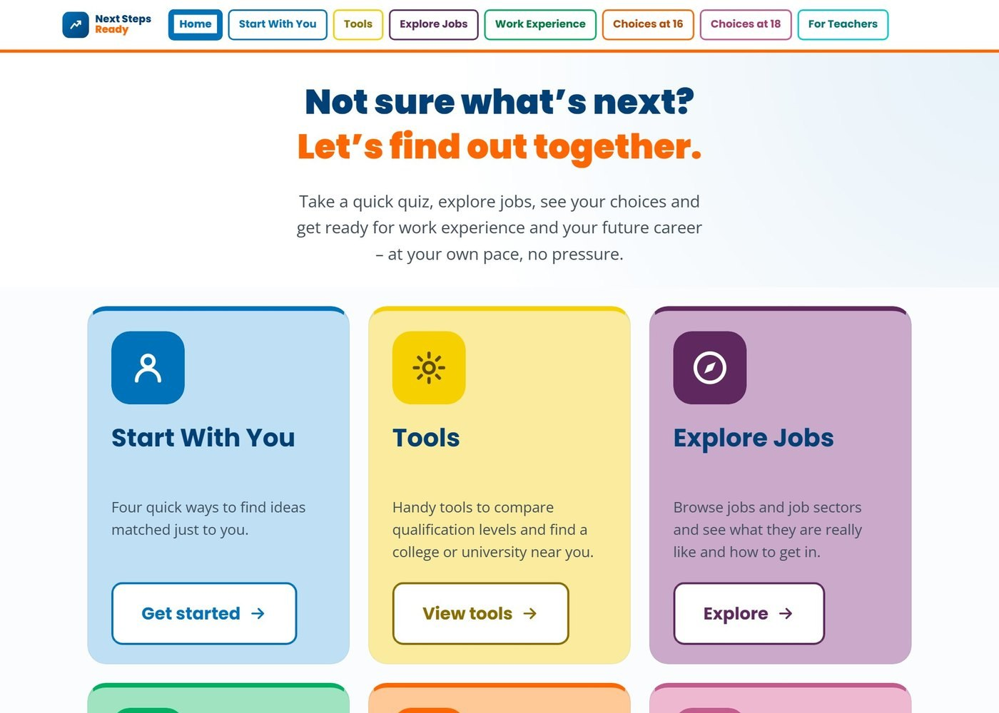


A website to help with your future career
nextstepsready.org.uk
Free for everyone
No login or password
Works on computers, tablets and phones
Notes:
Introduce Next Steps Ready: a free careers website with quizzes, tools and job information. There is no login, so students can use it in school and at home.
Today students will use the Skills Profile, in the Start With You section (circled).

Slide 13
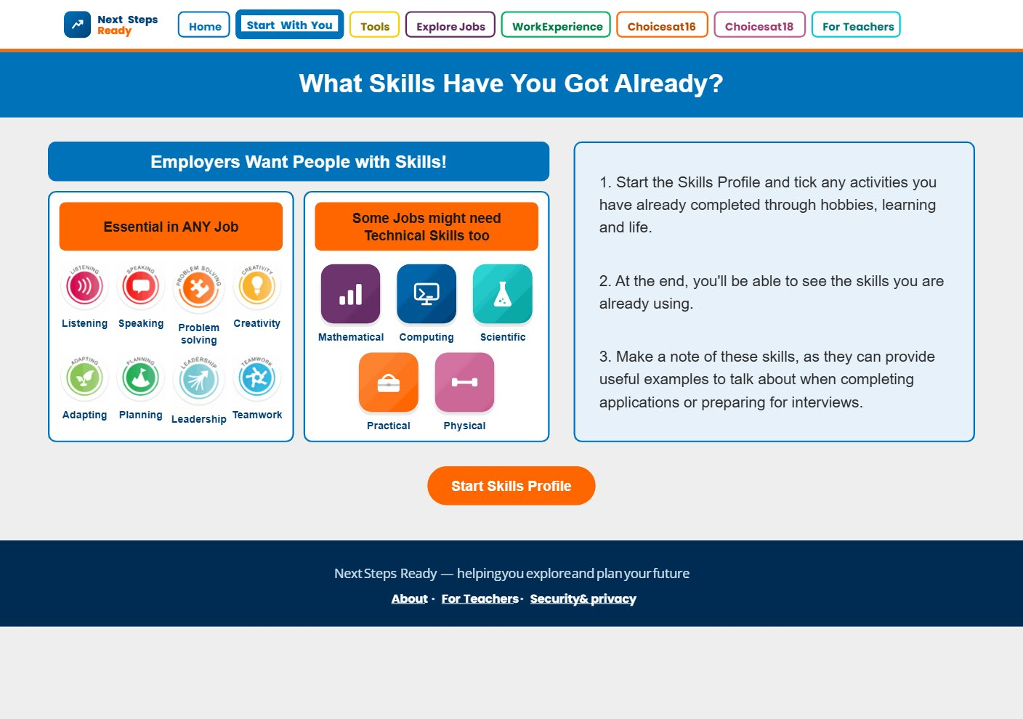
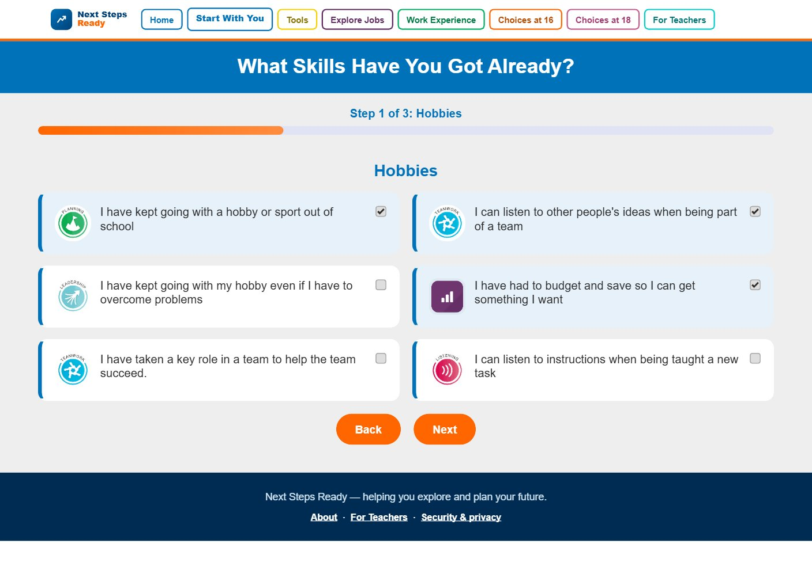
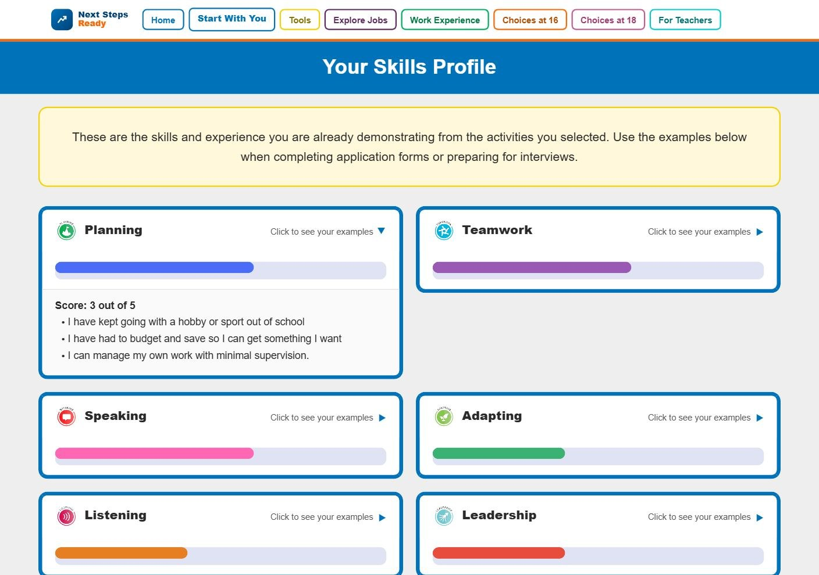
Task 1: What are your skills strengths?
1
Go to Start With You and open the Skills Profile
2
Tick the activities you have already done
3
See your skills – click a skill to see your examples
Write down your top three skills, with an example of where you have used and built each one.
10 mins
Notes:
Students go to nextstepsready.org.uk, choose Start With You, then the Skills Profile ("What Skills Have You Got Already?").
They tick the activities they have already done through hobbies, learning and life, over three short steps. At the end they see the skills they are already using; clicking a skill shows their examples.
Students write their top three skills, each with an example, on the My Skills sheet (slide 17).

Slide 14
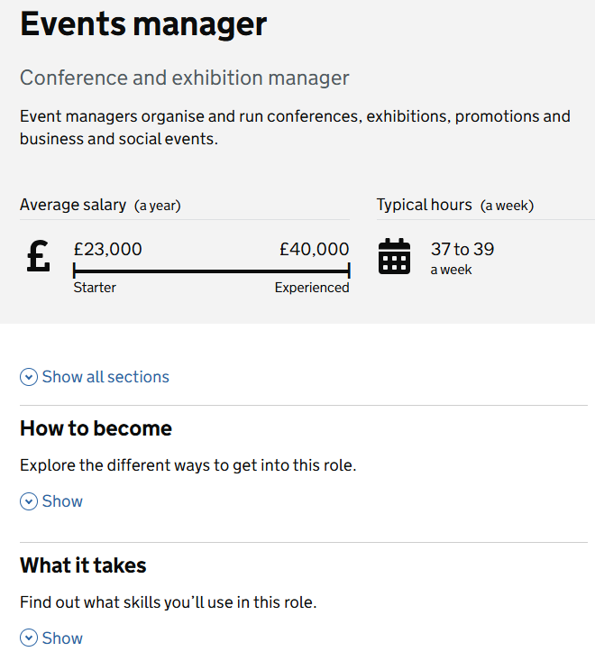
Task 2: Which skills does a job need?
Work in pairs:
1
Each find a job you find interesting on the National Careers Service (or through Explore Jobs on Next Steps Ready).
2
Open the job profile and click "What it takes" to see the skills you need.
3
Discuss which skills matter most and why, then write them in part 2 of your My Skills sheet.
10 mins
Notes:
Students choose a job they find interesting. They can search the National Careers Service (https://nationalcareers.service.gov.uk/explore-careers) or use Explore Jobs on Next Steps Ready, which links to each job sector.
On the job profile, the "What it takes" section lists the skills and knowledge needed for the role.
In pairs, students discuss which of the eight essential skills are most important for the job and why, and how these match their own skills strengths. Is there a skill they would like to develop?
Students write the job, its three most important skills and why in part 2 of the My Skills sheet, plus a skill they would like to develop.
You could give the example of a builder: problem-solving skills to adapt or solve building issues, teamwork skills to work with other trades and the client, and planning skills to work to plans and deadlines.

Slide 15

Sharing your skills
10 mins
With a partner, take it in turns to talk about your own skills and strengths.
Speak clearly and give examples of where you have been building your skills.
Listen carefully while your partner speaks. Show you are listening by asking questions to find out more.
Share with the class an example of your partner's top skill and where they have used it.
Notes:
Give students time to talk in pairs about their skills strengths.
This activity supports students to develop the following Skills Builder steps:
Step 8 Speaking – Using facts: I use facts and examples to support my communication
Step 8 Listening – Questioning: I ask open questions to understand more
You may want to check students' understanding of these skills steps. Ask students for feedback on how they feel they or their partner have shown these skills steps.

Slide 16


In this lesson you:
Talked about your skills strengths with others.
Recognised the skills needed for work and how to build them.
Found out that a career is your journey through life, learning and work.
Build your Skills Profile at home: nextstepsready.org.uk
Notes:
Recap the lesson with the class. Ask: which skill would you most like to develop? Where could you build it – in school, at home or in a club?
Remind students that they can use the Skills Profile on Next Steps Ready at home – it is free and there is no login. They can use their examples later in application forms and interviews.

Slide 17
My Skills
Name: ……………………………………………………………
1. My top three skills
Skill | Where I have used and built this skill (example)
1.
2.
3.
2. Skills for a job
A job I find interesting: ……………………………………………
Most important skills for this job | Why?
1.
2.
3.
A skill I would like to develop: ……………………………………………………………………………
Notes:
Printable sheet for Tasks 1 and 2. Print one copy per student.

