Slide 1




Teacher notes: Year 7 – Exploring jobs
This lesson aims to support students to:
Develop their career skills for life, learning and work
Prepare for the next career decisions they will have to make
Career development skills (CDI Framework)
Being aware that career describes their journey through life, learning and work
Looking forward to the future
Being aware of the range of possible jobs
Being aware of the range of different sectors and organisations where they can work
A one-hour careers lesson to help Year 7 students explore jobs, job sectors and workplaces.
Online version
Students need a computer, tablet or phone
Gatsby Benchmarks
Equalex Framework
Skills Builder
1, 2, 3, 4 and 6
Introduce & Inspire
Investigate & Explore
Notes:
These lessons have been developed to support students to build their career development skills, as identified by the CDI Career Development Framework. Each lesson identifies two outcomes linked to the CDI framework.
https://www.thecdi.net/CDI/media/Write/Framework/CDI_107-Framework_Handbook-web_Updated.pdf
The lessons will support meeting Gatsby Benchmark 1, 2, 3, 4 and 6 and support the Equalex Framework for preparing students for Modern Work Experience as they ‘Introduce & Inspire’ students about the world of work and ‘Investigate & Explore’ jobs and careers.
The lessons provide opportunities for students to practice their essential skills as identified in the Skills Builder Framework 2.0 - www.skillsbuilder.org/universal-framework/
The relevant skills steps are identified in the teacher notes in relevant activities, with reflection questions and prompts for discussion with students as part of the plenary.
This is the ONLINE version: each student needs a computer, tablet or phone with internet access for Tasks 1 and 2. Print the task sheet (slide 18), and the A–Z sheet (slide 17) if you want it for the warm-up. Ask your school or Trust IT team to make sure nextstepsready.org.uk is not blocked.

Slide 2

Lesson overview
Before the lesson: ask your school (and your Trust's) IT team to whitelist nextstepsready.org.uk. Each student needs a device. Print the task sheet (slide 18).
Timing | Slides | Activity | Resources
15 mins | 4–11 | Introduction: careers, jobs and why people work, A–Z of jobs warm-up (5 mins), jobs of the future | A–Z sheet (optional)
10 mins | 12–13 | Online Task 1: Job Sector Quiz on Next Steps Ready | Device per student, task sheet (slide 18)
20 mins | 14 | Online Task 2: explore jobs in your top job sector | Device per student, task sheet (slide 18)
10 mins | 15–16 | Share what you found, then wrap-up | –
Total: about 50 minutes. Timings are a guide – the Job Quiz and research can be extended.
Notes:
Use this overview to plan the lesson. The timings match the timers on the task slides.

Slide 3




In this lesson you will:
Explore a range of different jobs, job sectors and workplaces.
1
Understand that a career describes your journey through life, learning and work.
2
Careers lesson
Exploring jobs
Start to think about your future career.
3
Discover the jobs people do, the places they work and the jobs of the future.
Introduction
10 mins
Activities
30 mins
Sharing
10 mins
Notes:
This slide shows students what they will do in the lesson and how long each part takes.
The Career Development Institute has developed a careers framework that shows the skills everybody needs to have to manage their future career.
This slide shows the students which of the career learning areas (CDI) that this lesson links to. You can also share the structure of the session with students.

Slide 4




What is a career?
A career is an individual’s journey through life, learning and work.
It is all about YOU!
Work Experience
Part time
Throughout your career you may have many jobs.
Notes:
Explain that a career is your journey through life, learning and work. Reveal each stop on the journey: work experience is often one of the first steps, then perhaps a part-time job, and throughout your career you may have many different jobs.
Ask: what might be the first stop on your career journey?

Slide 5




What is a job?
A job is work that a person does regularly to earn money and help provide a service, make something, or support other people.
A builder helps create houses and buildings.
A teacher helps students learn.
A doctor helps people stay healthy.
Notes:
Ask students if they know what a job is.
Encourage students to explain what is meant by the word job, then reveal the answer.
Look at the photos: how does each of these jobs help other people?

Slide 6





Why do we work?
There may be many different reasons why people choose to do the jobs they do…
Can you think of reasons why people work?
To make money to pay for things
To do something they enjoy or are good at
To support other people
To help to protect our planet
Notes:
Ask students why people work, then reveal the four reasons one by one.
Ask: what other reasons can you think of? (for example, to meet people, to learn new things, to be independent).

Slide 7



Exploring jobs: A to Z
There are lots of different jobs you could do.
1
Work in pairs or small groups.
2
Think of a different job for every letter of the alphabet.
3
Write the job titles down in order.
A – Actor
B – Builder
C – Cook…
8 mins
Notes:
Students must work in pairs to write down job titles for each letter of the alphabet. Print off slide 17 (the A–Z sheet) to support students to complete this warm up activity.
They have 5 minutes to work together.
When the time is up, work as a class to quickly go through the letters of the alphabet getting students to contribute ideas for each letter.
Use the following slide to help with any letters that are missing.
Students can build their Teamwork skill at Step 7: Contributing: I contribute to group activity

Slide 8
Jobs you might have picked…
A
Actor
N
Nurse
B
Baker
O
Optician
C
Cook
P
Paramedic
D
Dancer
Q
Quarry Worker
E
Electrician
R
Recycling Operative
F
Farmer
S
Sports Coach
G
Gardener
T
Teacher
H
Hotel Manager
U
User Researcher
I
Ice Cream Seller
V
Vlogger
J
Jewellery Designer
W
Web Designer
K
Kitchen Fitter
X
X-Ray Technician
L
Librarian
Y
Youth Worker
M
Musician
Z
Zookeeper
Notes:
Extension:
Class discussion opportunities around what the job title means, what would people do if they did this job? Does anyone know anyone who does the different jobs listed?
Use the National Careers Service to look up any of these job profiles to find out more about the role.
https://nationalcareers.service.gov.uk/explore-careers

Slide 9

Jobs of the future
Technology and science are developing fast to improve our lives in many ways.
As the world changes, the jobs people do will change too.
When you are adults, you may be doing jobs that don't even exist yet!
Notes:
How is technology and science developing?
You may want to elicit understanding of what we mean by this.
Discuss AI. Where we use technology in our every day lives – phones, computers etc. Scientific advances – e.g. electric self driving cars etc.

Slide 10




How is technology changing these jobs?
Teacher
Sales assistant
How might technology change this job?
How might technology change this job?
Farmer
Warehouse worker
How might technology change this job?
How might technology change this job?
Notes:
Class discussion: Ask the students what jobs are the images showing – then discuss how technology might change these jobs in the future.
Technology makes many jobs easier but could mean some jobs will change or are not needed at all!
Teachers – Teachers can record their lessons for students to watch back online. They could add captions and videos to help learners or even language translations. Computers also make it easier for students to learn on their own from home. Could some teachers be replaced by robots?? What would be good or bad about that?
Shop Assistants - In shops, people can pay using their phones and may not always need a person to serve them. Have you used a self-checkout in a shop? Could a robot provide customer service as well as a human can?
Farmers – They are already using technology to look at data to help plan what they grow and when to get the best harvest. Could farmers use automatic driverless tractors in the fields? Is this a good idea?
Warehouse workers – Robots are already being used to help people working in a warehouse – what jobs might robots do to help?

Slide 11




Which job sectors will grow in the future?
Health and Science
Digital
Construction
Green Jobs
Improving people's health, wellbeing and quality of life
Creating, managing and improving technology
Designing and developing houses and places
Protecting the environment
Notes:
With new technology and science developments there will be a growth in jobs needed in many industry sectors including:
Medical and Health – we will continue to need more medical scientists, researchers, doctors, nurses and health care workers to help improve people’s health, wellbeing and quality of life
IT and Digital – we will need more data analysts, technology researchers and AI and software developers to create, manage and improve digital technology and how we use AI
Construction - we will need more people to design and build the new buildings and places of the future – architects, electricians, energy engineers
Green jobs– we need lot of people to do jobs that help protect our planet and natural environment like ecologists, foresters and environmental advisers
You might use the National Careers Service job sectors to explore each of these in more detail: https://nationalcareers.service.gov.uk/explore-careers/job-sector

Slide 12
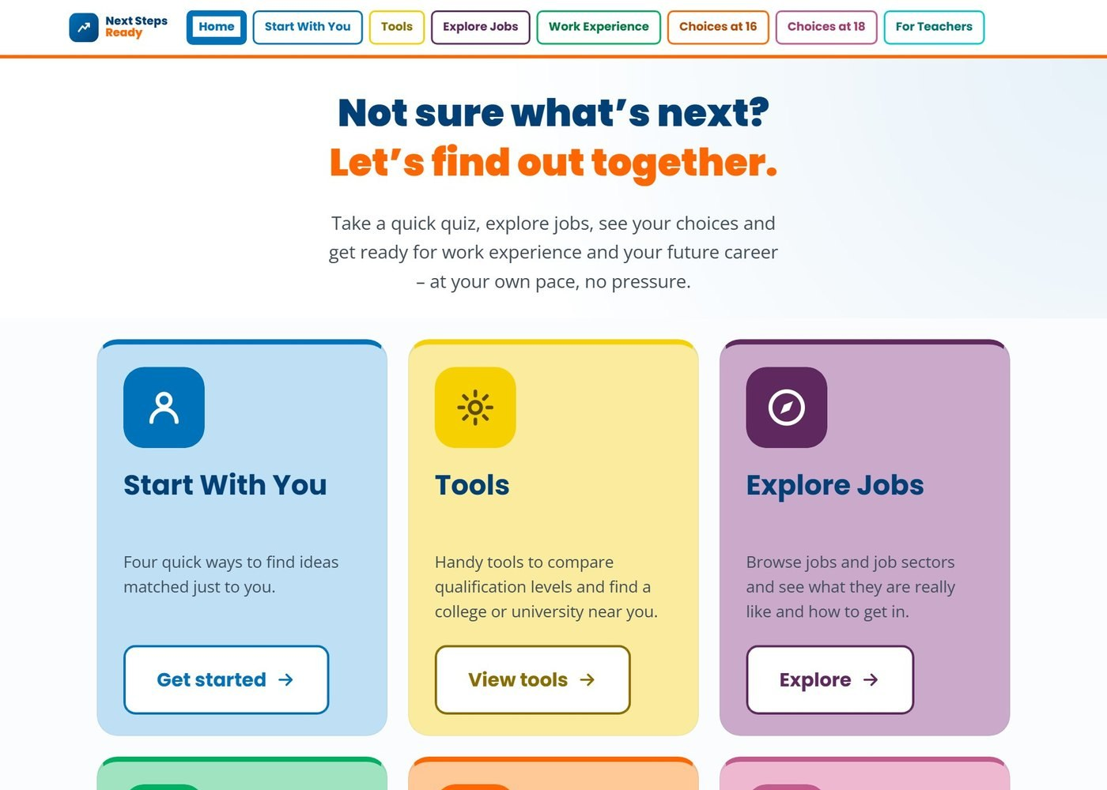


A website to help with your future career
nextstepsready.org.uk
Free for everyone
No login or password
Works on computers, tablets and phones
Notes:
Introduce Next Steps Ready: a free careers website with quizzes, tools and job information. There is no login, so students can use it in school and at home.
Today students will start with the Job Quiz, in the Start With You section (circled).

Slide 13
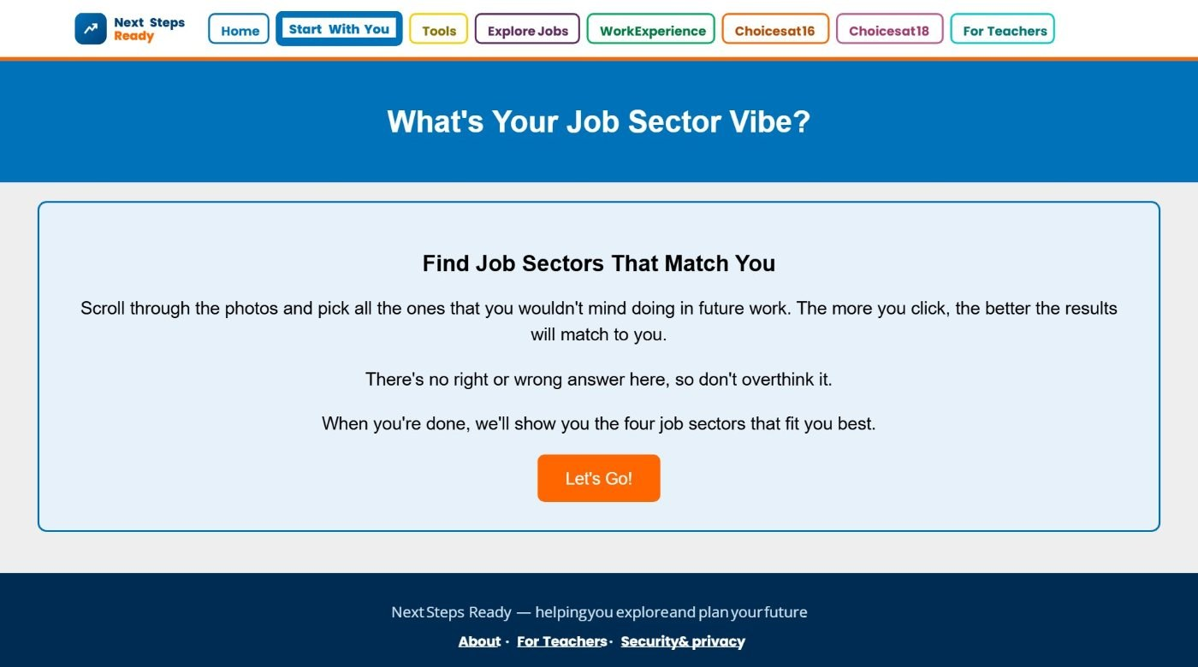
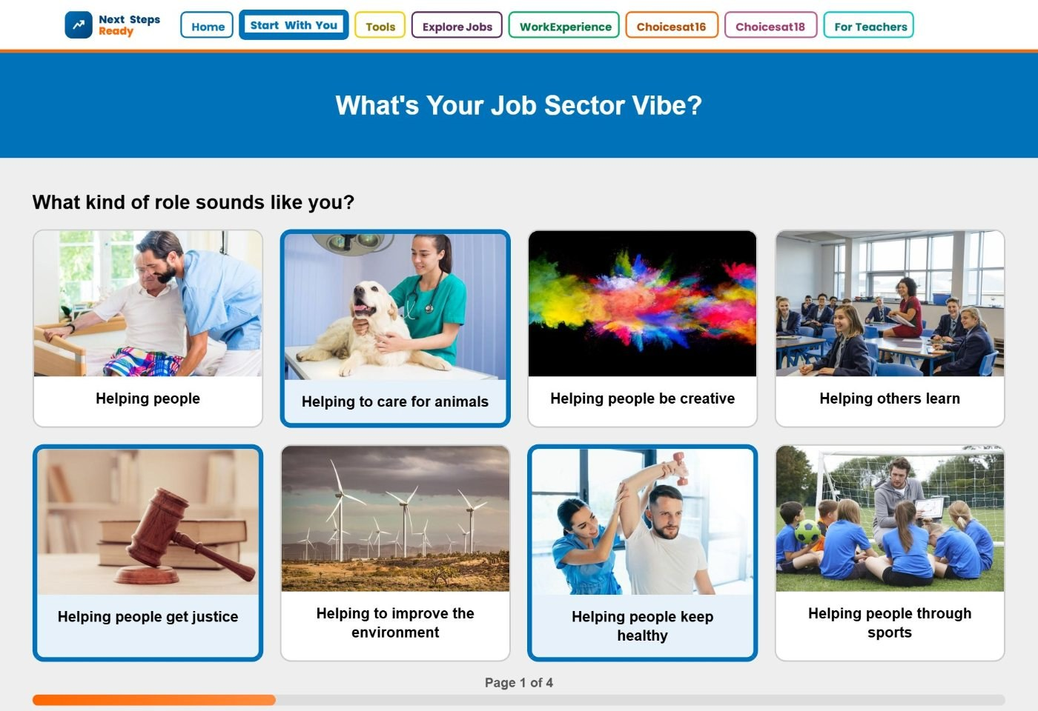
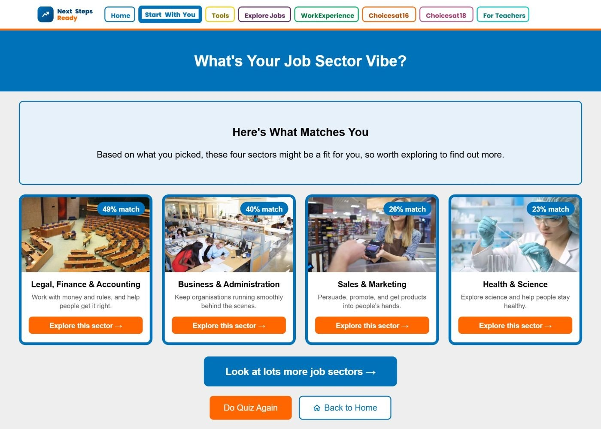
Task 1: Which job sectors suit you?
1
Go to Start With You and open the Job Quiz
2
Click all the photos of work you wouldn't mind doing
3
See your top four job sectors
Have you thought about the type of job you might want to do one day? What job sector might suit your interests?
10 mins
Notes:
Students go to nextstepsready.org.uk, choose Start With You, then the Job Quiz ("What's Your Job Sector Vibe?").
They click all the photos of work they wouldn't mind doing – there are no right or wrong answers – then see the four job sectors that match them best.
Ask students to note down their top job sector: they will explore it in Task 2.
Students record their answers on the task sheet (slide 18).

Slide 14
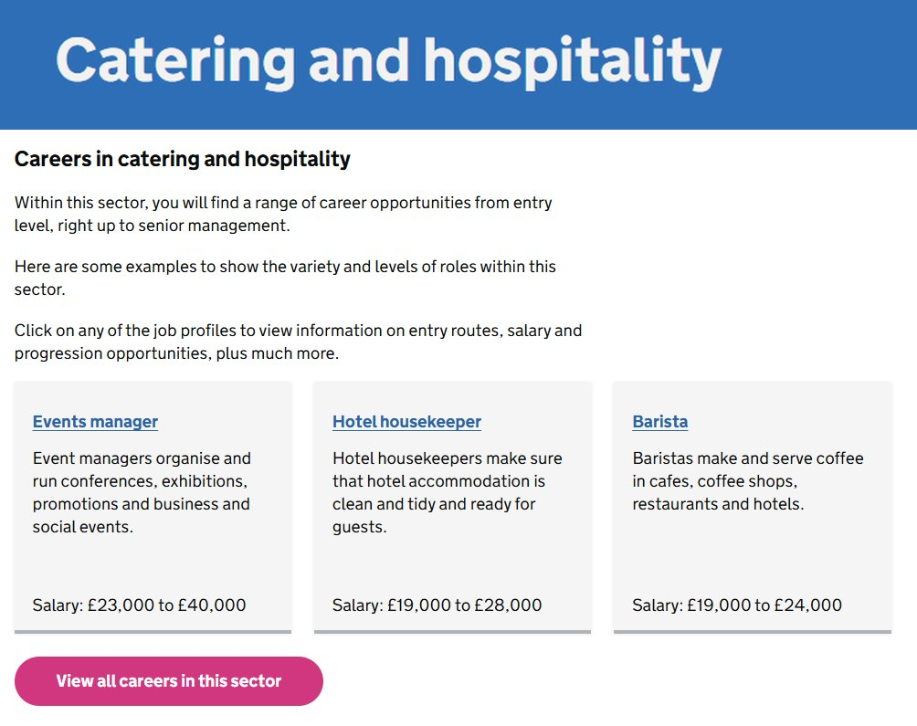

Task 2: Explore jobs in your top sector
1
Click "Explore this sector" on your top result
2
Look at the jobs on the National Careers Service
3
Pick three jobs that interest you
For each job, find out:
what the job involves
the typical salary
how to get into it
Write your three jobs on your task sheet so you can share them with your partner.
20 mins
Notes:
Students click "Explore this sector" on their top job sector. This opens the job sector page on the National Careers Service.
They pick three jobs that interest them and find out what each job involves, the typical salary and how to get into it. They can note these down to share in the next activity.
If a student's sector page has too many jobs, suggest they start with the examples near the top.
https://nationalcareers.service.gov.uk/explore-careers/job-sector
Students record their answers on the task sheet (slide 18).

Slide 15
Share what you found
10 mins
Take it in turns in your pairs to share your top job sector and the three jobs you found.
Speak clearly. Explain which job sector you explored, the three jobs you chose and why they interest you.
Listen carefully while others are talking and show that you are paying attention.
Notes:
This activity can support students to build the following skills steps:
Step 5 Speaking: Speaking clearly
I speak clearly and in an order that makes sense to others
Step 7 Listening: Active listening
I show I am paying attention
https://www.skillsbuilder.uk/universal-framework-steps/listening-step-7-active-listening

Slide 16


In this lesson you:
Explored a range of different jobs, job sectors and workplaces.
Found out that a career is your journey through life, learning and work.
Started to think about your future.
Keep exploring jobs at home: nextstepsready.org.uk
Notes:
Recap the lesson with the class. Ask: which job sector would you like to find out more about? Did anyone find a job they had never heard of before?
Remind students that they can use Next Steps Ready at home – it is free and there is no login.

Slide 17
Think of a job role for every letter of the alphabet
Names: ……………………………………………………………
A | Actor
B | Banker
C | Chef
D
E
F
G
H
I
J
K
L
M
N
O
P
Q
R
S
T
U
V
W
X
Y
Z
Notes:
Printable sheet for the A–Z warm-up. Print one copy per pair.

Slide 18
Task sheet: exploring job sectors
Name: ……………………………………………………………………
Task 1: Job Sector Quiz – write down your top four job sectors
1
2
3
4
Circle your top job sector – you will explore it in Task 2.
Task 2: Explore jobs in your top sector – pick three jobs that interest you
Job | What the job involves | Typical salary | How to get into it
1.
2.
3.
Which job interests you most, and why? ……………………………………………………………………………………………
Notes:
Printable task sheet for the online Tasks 1 and 2. Print one copy per student (or per pair).
Task 1: students write down the four job sectors from their Job Quiz results and circle their top one.
Task 2: students explore their top sector on the National Careers Service and note three jobs – what each job involves, the typical salary and how to get into it. They use the sheet to share what they found in the next activity.

