Slide 1




Teacher notes: Year 11 – Preparing for post-16
This lesson aims to support students to:
Develop their career skills for life, learning and work
Prepare for the next career decisions they will have to make
Career development skills (CDI Framework)
Recognising the main learning pathways, considering which one they want to follow and how they will access and succeed in it
Taking steps to achieve in their GCSEs and make a decision about their post-16 pathway
Making plans and developing a pathway into their future
A one-hour careers lesson to help Year 11 students understand their post-16 pathways and make a plan.
Online version
Each student needs a device with internet access
Gatsby Benchmarks
Equalex Framework
Skills Builder
1, 2, 3, 4 and 6
Introduce & Inspire
Investigate & Explore
Notes:
These lessons have been developed to support students to build their career development skills, as identified by the CDI Career Development Framework. Each lesson identifies outcomes linked to the CDI framework.
The lessons support meeting Gatsby Benchmarks 1, 2, 3, 4 and 6 and the Equalex Framework for preparing students for Modern Work Experience, as they 'Introduce & Inspire' students about the world of work and 'Investigate & Explore' jobs and careers.
The lessons give students opportunities to practise their essential skills, as identified in the Skills Builder Universal Framework 2.0: www.skillsbuilder.org/universal-framework
The relevant skills steps are identified in the teacher notes for each activity, with reflection questions and prompts for discussion as part of the plenary.
This is the ONLINE version: students need individual access to a device with internet. Before the lesson, ask your school (and your Trust's) IT team to whitelist nextstepsready.org.uk.

Slide 2

Lesson overview
Before the lesson: ask your IT team to whitelist nextstepsready.org.uk. Each student needs a device. Print the My Post-16 Plan sheet (slide 23) and have your school’s sixth form web address ready for Task 2.
Timing | Slides | Activity | Resources
10 mins | 4–9 | Warm-up (lottery holiday), what is a career, future jobs, get ready for your future career | Video link (optional)
10 mins | 10–17 | Post-16 pathways: qualifications ladder, different routes, vocational, T Levels, apprenticeships, A levels | –
10 mins | 18–19 | Online Task 1: explore the pathways in Choices at 16 and put your top 3 in order | Device, My Post-16 Plan sheet
20 mins | 20 | Online Task 2: research courses or apprenticeships – school sixth form website, Find a College or University, or Find an apprenticeship | Device, My Post-16 Plan sheet
5 mins | 21–22 | Use your supporters, then wrap-up | –
Total: about 55 minutes. Timings are a guide – you could split the lesson over two sessions.
Notes:
Use this overview to plan the lesson. The timings match the timers on the task slides.

Slide 3




In this lesson you will:
See how your post-16 choices fit with future jobs and your career.
1
Find out about A levels, vocational courses, T Levels and apprenticeships.
2
Careers lesson
Preparing for post-16
Make a plan and develop a pathway into your future.
3
Explore all your options after Year 11 and make a plan for your future.
Introduction
10 mins
Activities
40 mins
Wrap-up
5 mins
Notes:
This slide shows students what they will do in the lesson and how long each part takes.
The Career Development Institute has developed a careers framework that shows the skills everybody needs to manage their future career. These aims link to the CDI career learning areas.

Slide 4


Warm-up
You have won the lottery!
A holiday in one of these places:
Barbados
Australia
Which one will you choose?
South Africa
Belgium
The prize is…
England
Notes:
Warm-up activity. Students think about which place they would choose as their prize – they don't have to say.

Slide 5


Just found out more detail…
Barbados
Beach ranger
Explore ALL the information before you decide!
Australia
Sheep shearing
South Africa
Picking grapes
Belgium
Testing chocolate
England
Glastonbury tickets
Which place do you want to go to now?
Notes:
Knowing the detail can make all the difference – and it's the same with choosing your career options. You need to know the detail, not just 'I am going to go to college or sixth form', but which course, where it will take you, and so on.

Slide 6


What is a career?
A career is an individual's journey through life, learning and work.
A job is something you might do to earn money as part of your career journey. There are lots of job sectors you could work in – from finance, to art and design, to working with animals.
Year 11: the big career things
Explore all your options and firm up what you will do at the end of Year 11
Get the best GCSEs you can
Notes:
Explain what a career is, and that jobs are part of their career journey (and they might have lots of them).
Then share the key things related to careers that Year 11 students will be focusing on this year.

Slide 7





Where are future jobs going to be?
Medical, health science and care
IT and digital technology
Engineering and construction
Environmental (green jobs)
Medical scientists, researchers, doctors, nurses, care workers
Data analysts, technology researchers, AI developers
Architects, electricians, energy engineers
Ecologists, foresters, environmental advisers
This is Labour Market Information (LMI): be in the know to know where to go.
Notes:
With new technology and science developments there will be growth in jobs in many sectors, including:
Medical and health – more medical scientists, researchers, doctors, nurses and health care workers
IT and digital – more data analysts, technology researchers and AI developers
Engineering and construction – more people to design and build the buildings of the future: architects, electricians, energy engineers
Environmental – lots of people to do jobs that help protect our planet, like ecologists, foresters and environmental advisers.

Slide 8




Get ready for your future career
Watch the video: why careers matter and what you can do now
www.youtube.com/watch?v=OWZxyyK6OuA
TODAY
1
2
3
4
Know yourself
Do stuff
Know all your options
Use your supporters
What are you good at? What do you enjoy?
Activities, clubs, volunteering and work experience
Find out about every pathway – that's today!
Family, teachers, careers advisers
Notes:
Why are careers important, and what can you do NOW?
Show the video: https://www.youtube.com/watch?v=OWZxyyK6OuA
Talk through the four steps. Today's lesson focuses on step 3: know all your options.

Slide 9




Keep doing stuff!
Volunteering
Cadets
Duke of Edinburgh's Award
Youth groups
Your number 1 priority:
your GCSEs
Sports teams
Performing arts
But don't give up anything that will be useful for a future job, course or CV.
Don't drop them! Great for your CV
Notes:
Yes, students' number 1 priority needs to be their GCSEs – but they shouldn't give up anything that will be useful for a future job, course or CV.
Ask: what activities do you do outside lessons? What skills do they show?

Slide 10



Pathways after Year 11
What pathways can I choose at the end of Year 11?
Academic
Technical & vocational
Work-based
A levels
Vocational courses and T Levels
Apprenticeships
Mostly in a sixth form or sixth form college
Mostly in a local college, but some in schools
Mostly in a workplace – training on the job, and you get paid
Every pathway can lead on to university, an apprenticeship or a job.
Notes:
Ask students to say which pathways they can take at 16, then reveal the three main pathways.

Slide 11
Qualification choices
Every pathway has qualification levels – and every pathway can lead to a degree.
Academic
Technical & vocational
Apprenticeships
Level 6
Degree achieved
Your choices after GCSEs are mostly at Levels 2 and 3.
Level 5
Degree Year 2
HND / Foundation Degree Year 2
Higher Apprenticeship
Level 4
Degree Year 1
HNC / Foundation Degree Year 1
Higher Apprenticeship
Level 3
A levels
T Level, BTEC / OCR and other Level 3
Advanced Apprenticeship
See every level, up to Level 8:
Tools › Qualification Ladder on nextstepsready.org.uk
Level 2
5 GCSEs at grades 4–9
T Level Foundation and other Level 2
Intermediate Apprenticeship
Level 1
GCSEs at grades 1–3
Notes:
Explain that there are three pathways, and in all of them there are levels of qualifications. Level 2 is getting 5 GCSEs at grades 4–9.
Show students the other levels and make the point that all pathways can lead to a degree.
The part of the ladder we are mainly talking about today is their choices after GCSEs (Levels 2 and 3, highlighted).

Slide 12

Different routes to the same job
Lucy and Leon are both nurses – but they took different routes after their GCSEs.
BTEC Health and Social Care at college
Nursing degree at university
Nurse
Lucy
A levels
Hospital porter
Healthcare degree apprenticeship
Nurse
Leon
There are lots of ways to get to the same future job.
Notes:
There are many ways to reach the same career (although some have very set routes, like doctor or vet, so students need to check).
Lucy and Leon are both nurses.
Lucy did a BTEC in Health and Social Care after her GCSEs, then a degree.
Leon did A levels, then started work in a hospital as a porter. He was offered a healthcare apprenticeship and achieved his degree through this route.
A common pathway into nursing and paramedic work is through working in a hospital and then being given the opportunity for further training.

Slide 13
Choosing options: what to think about
What grades are you likely to get at GCSE (especially English and maths)?
How do you like to learn – by doing, or by studying?
Some people start with what they want to do in the future (a course or job) and look at what they need to do to get there.
Some people start with a subject they like and focus on a job later.
Notes:
Talk through what students need to think about when choosing their post-16 options.

Slide 14
Technical and vocational pathway
Vocational courses are about a job area.
Colleges offer lots of vocational courses at lots of levels. Schools offer some too.
Example courses
1
Accounts Level 2
Some colleges offer A levels, some don't. You can resit your maths and English GCSEs at college.
2
Animal care and management Levels 1 and 2
Health and social care Levels 1 and 2
Many Level 3 vocational courses need 4 or more GCSEs at grade 4+ (check this).
3
Plumbing Levels 1, 2 and 3
Digital design (T Level) Level 3
Level 3 courses give you UCAS points, which can get you onto a higher-level course.
Sport Levels 1, 2 and 3
Notes:
Key facts about vocational courses: colleges offer lots of them, some quite specialist (like boat building or agriculture). Many colleges don't offer GCSEs or A levels, but all colleges support students who don't get grade 4 or above in maths and English at GCSE.
In some areas schools don't have sixth forms, and colleges are the providers for A levels – you might want to adapt this slide to suit your area.

Slide 15
Technical pathway: T Levels
T Levels train you for a specific job area. They are mostly taught in colleges.
2 years
3 A levels
45 days
80% / 20%
a Level 3 qualification
1 T Level is worth the same UCAS points
on an industry placement with an employer
classroom time / placement time
Some T Level subjects:
Digital
Health
Healthcare science
Science
Education and early years
Engineering
Onsite construction
Building services engineering
Accounting
Agriculture
T Levels give you UCAS points, which can get you onto a higher-level course.
Notes:
T Levels are fairly new and are mostly offered in colleges. They last two years, include an industry placement of at least 45 days, and one T Level is worth the same UCAS points as three A levels.
New T Levels are still being added – check the full list at www.tlevels.gov.uk and with your local colleges.

Slide 16



Work-based pathway: apprenticeships
Levels 6–7
Degree apprenticeship
Earn while you learn
At least £8.00 an hour (apprentice minimum wage from April 2026) – many employers pay more.
Levels 4–5
Higher apprenticeship
Learn by doing the job
Level 3
Advanced apprenticeship
Most of your time is in the workplace, with some study at college or a training provider.
Level 2
Intermediate apprenticeship
Apply like a job
You need to find and apply for a vacancy – just like finding a job.
Starting at 16? Most start at Level 2 or 3.
Notes:
Apprenticeships are real jobs with training. Apprentices are employed, paid, and work towards a qualification.
Pay: the apprentice minimum wage is £8.00 an hour from April 2026 (for apprentices under 19, or in the first year of their apprenticeship). Many employers pay more. Check the current rate at www.gov.uk/national-minimum-wage-rates each year.
Students need to find and apply for an apprenticeship, like finding a job – they can search for vacancies at www.gov.uk/apply-apprenticeship.

Slide 17
Academic pathway: A levels
A levels (Level 3)
Other Level 3 vocational qualifications
Usually take 3 (sometimes 4)
AS levels – in some schools
Extended Project Qualification (EPQ)
Level 3 Core Maths
Mostly exams at the end of two years
Related to a job area
Small – the same size as 1 A level
Large – the same size as 2 or 3 A levels
Can sometimes be taken alongside A levels
Each gives you UCAS points, which can get you onto a higher-level course.
Notes:
A levels – key facts. Students usually take three (sometimes four). Some schools offer AS levels. Many sixth forms also offer the Extended Project Qualification and Level 3 Core Maths.
Other Level 3 vocational qualifications (such as BTECs or Cambridge Technicals) are related to a job area and come in different sizes. Check what your local sixth forms and colleges offer.

Slide 18
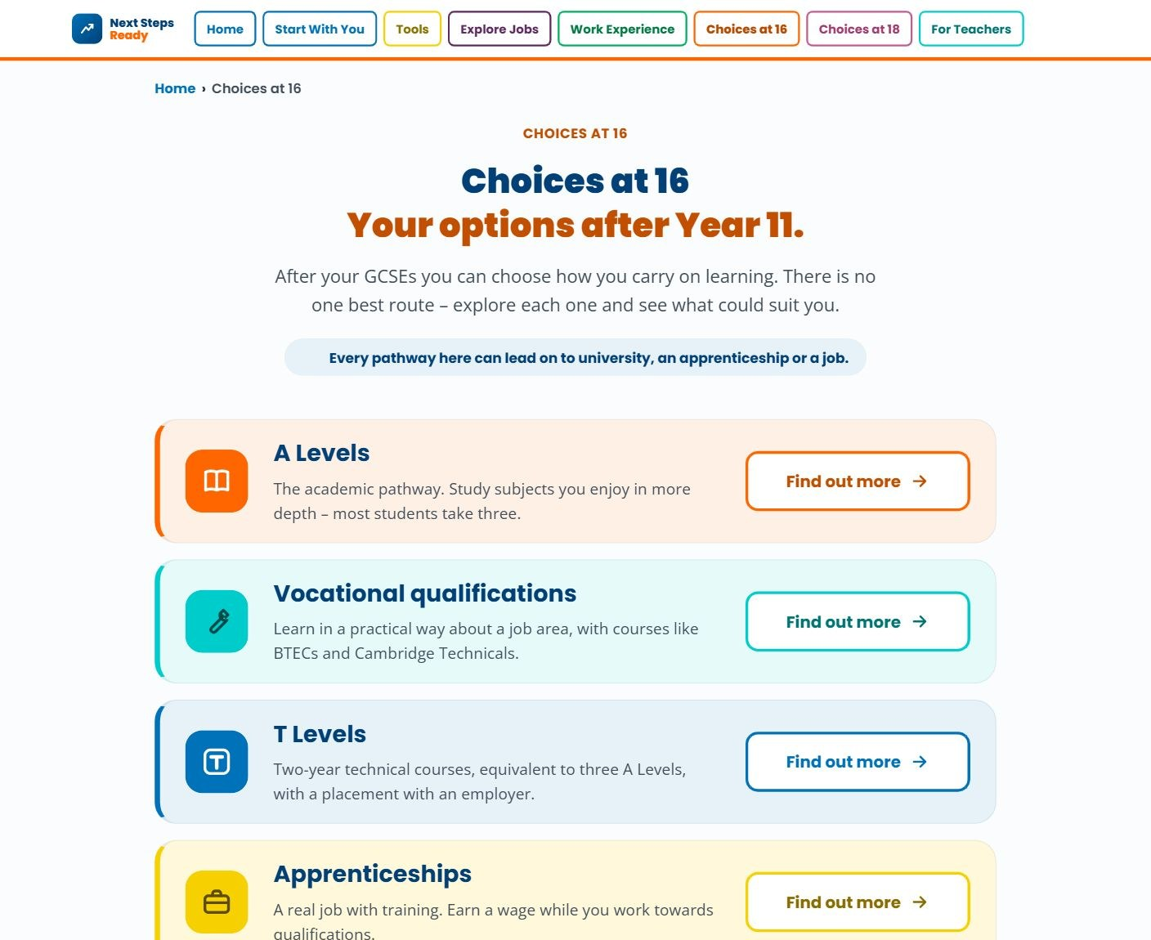


A website to help with your choices at 16
nextstepsready.org.uk
Free for everyone
No login or password
Every post-16 pathway explained
Notes:
Introduce Next Steps Ready: a free careers website with no login, so students can use it in school and at home.
The Choices at 16 section (circled) explains A levels, vocational qualifications, T Levels, apprenticeships and how each pathway can lead on to a degree later.

Slide 19
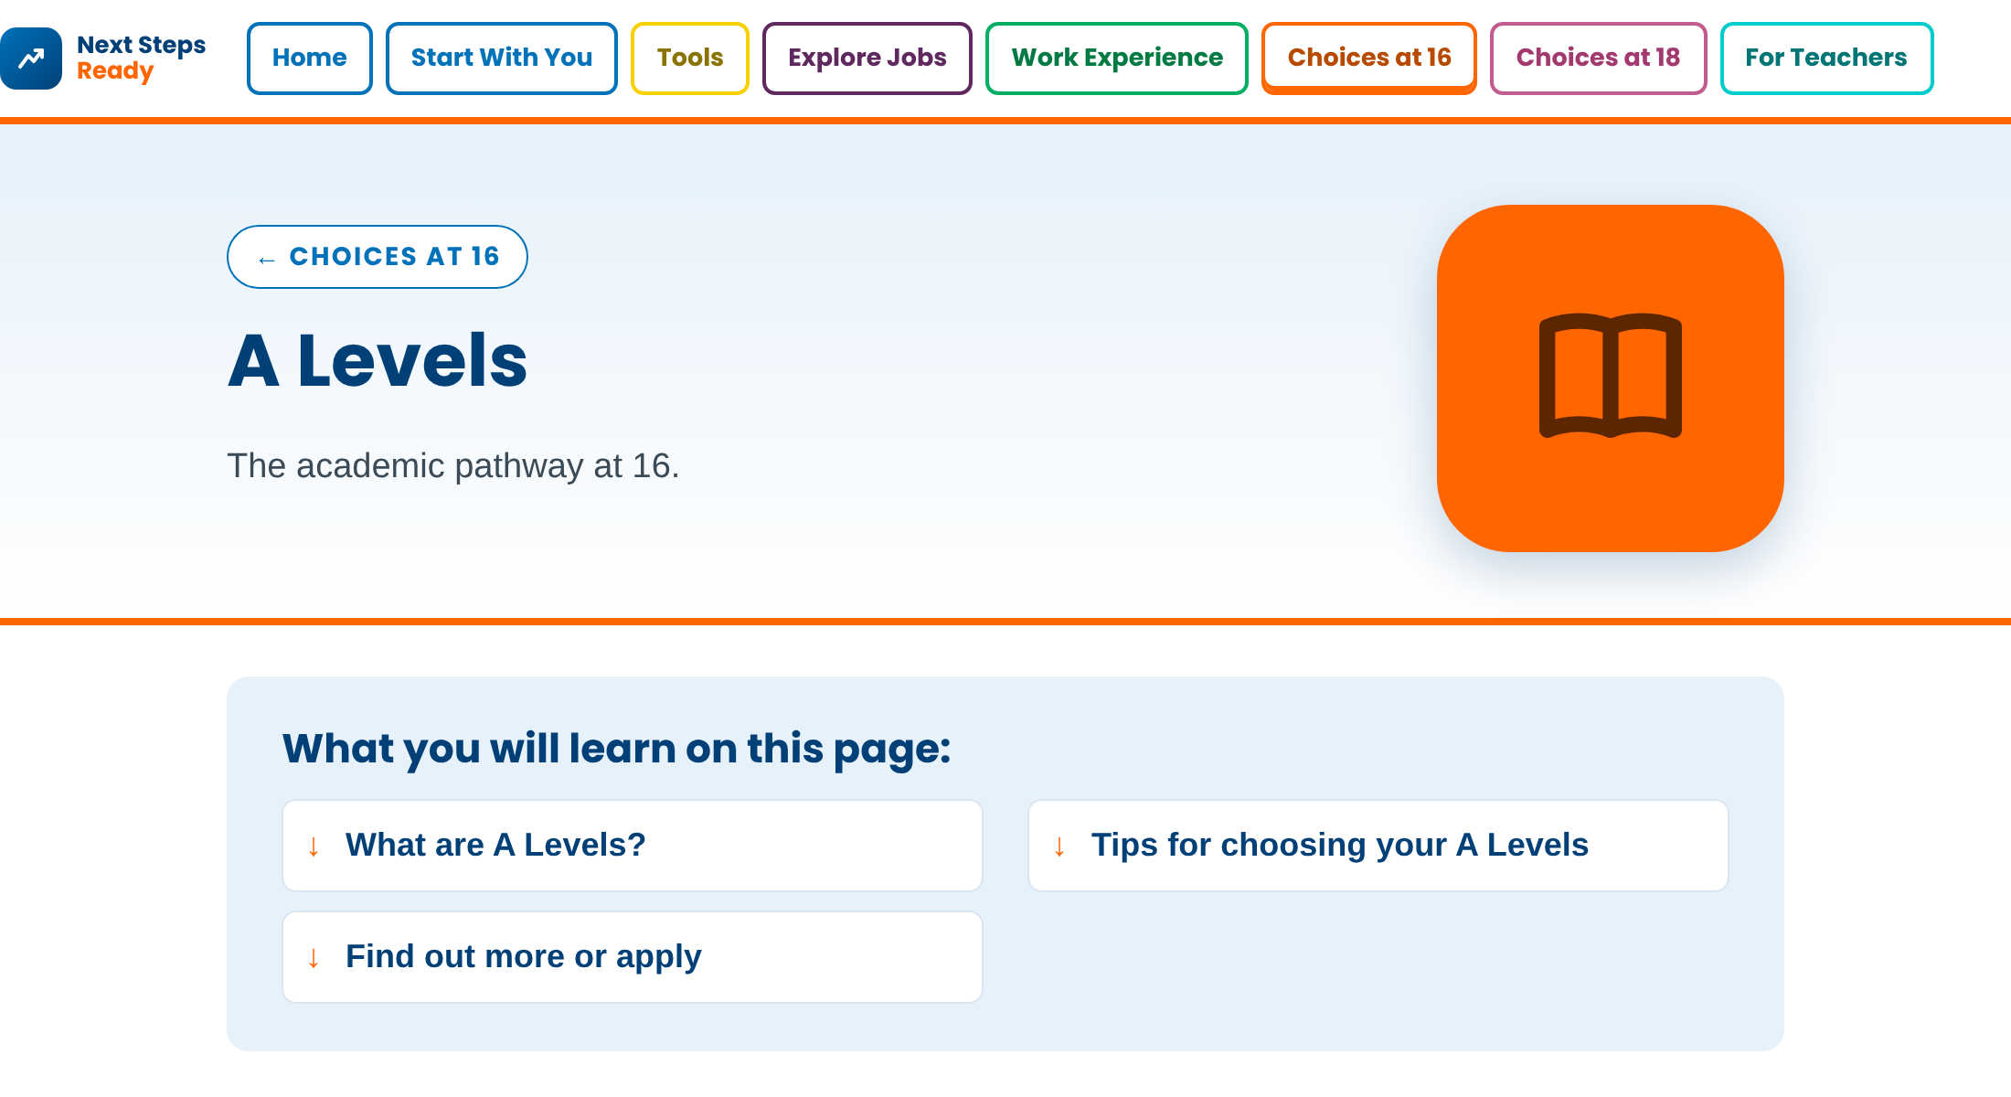
Task 1: Explore the pathways
1
Go to Choices at 16
2
Click “Find out more” on each pathway and read about it
3
Put them in order
On your My Post-16 Plan sheet, write your top 3 pathways in order:
1 = the one you are most interested in
A levels, vocational courses, T Levels or apprenticeships
say why your number 1 suits you
Not sure yet? That’s fine – put them in the order that interests you most today.
10 mins
Notes:
Students go to nextstepsready.org.uk and open Choices at 16. They click “Find out more” on each pathway – A levels, vocational qualifications, T Levels and apprenticeships (and Thinking of a degree later) – and read what each one involves and the things to think about.
On the My Post-16 Plan sheet (slide 23) they write their top 3 pathways in order, 1 = most interested, and say why their number 1 suits them.
If there is time, take a quick show of hands: whose number 1 is A levels? Vocational courses? T Levels? Apprenticeships?

Slide 20
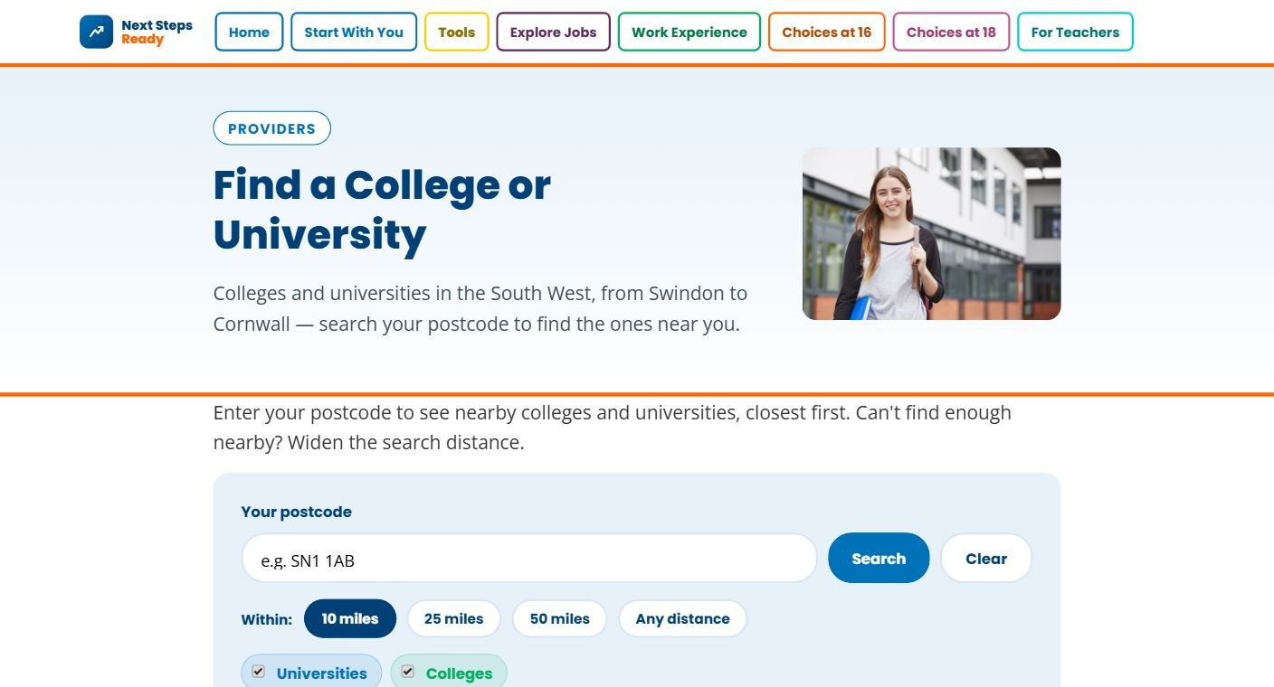
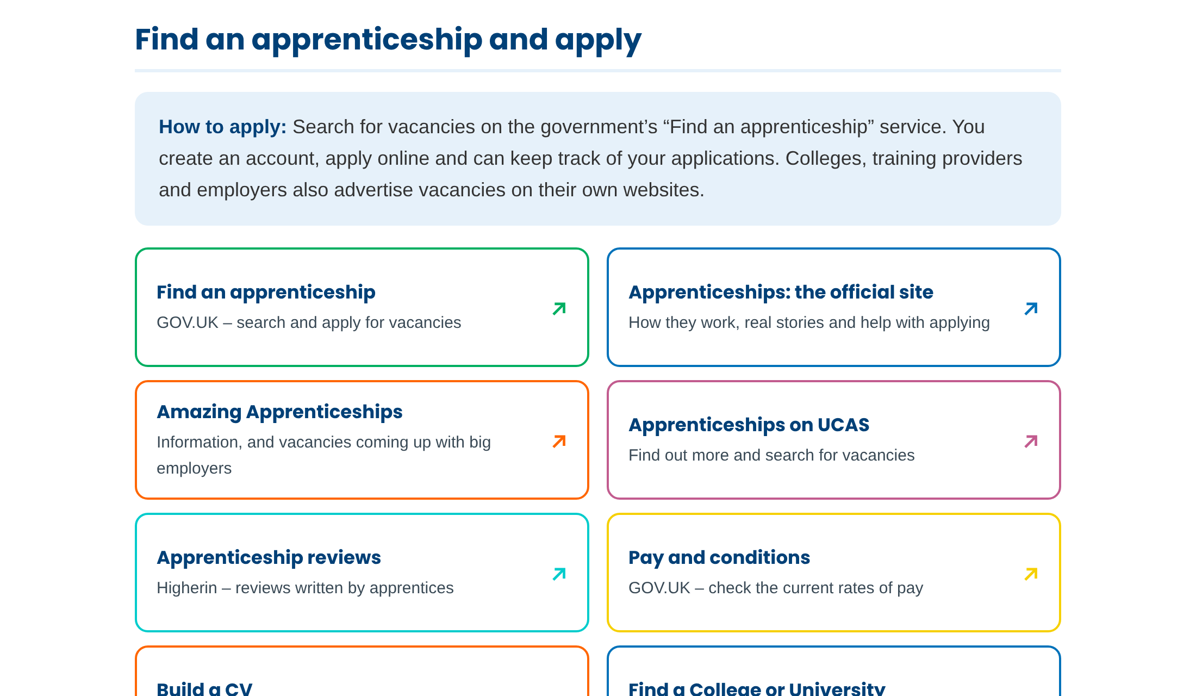
Task 2: Research your options
A
Your school’s sixth form website
B
Find a College or University – enter your postcode
C
Choices at 16 › Apprenticeships: Find an apprenticeship
Look at the sixth form or post-16 pages on your school’s website, or another school:
which courses are offered?
what are the entry requirements?
when is the open evening?
Choose ONE option. Find 2–3 courses or apprenticeships and note where they are, the entry requirements and open day or application dates on your sheet.
20 mins
Notes:
Students choose ONE way to research, ideally linked to their number 1 pathway from Task 1:
A. Your school’s sixth form website – the courses on offer, entry requirements and open evening date (give students the web address).
B. Find a College or University (in Tools) – enter a postcode to see nearby colleges, then look at a college’s courses on its own website.
C. Choices at 16 › Apprenticeships › Find an apprenticeship and apply – search for vacancies on GOV.UK Find an apprenticeship and the other sites listed.
They find 2–3 courses or apprenticeships and record where they are, the entry requirements and open day or application dates on the My Post-16 Plan sheet (slide 23), plus a back-up plan.
Make sure students looking at apprenticeships know that they will need to look for vacancies nearer they preferred start date as these are live.

Slide 21



Use your supporters
Parents and family
Teachers
Careers advisers
Next Steps Ready
Just ask! Who else could help you?
Our school careers adviser is: ………………………………………………
Notes:
When students are back as a group, talk about supporters and see if they can suggest any others.
Tell them the name of the school careers adviser and how to book an appointment (you can type it in on this slide).

Slide 22


In this lesson you:
Saw how your post-16 choices fit with future jobs and your career.
Found out about A levels, vocational courses, T Levels and apprenticeships.
Started to make a plan for your future.
Explore your choices at home: nextstepsready.org.uk › Choices at 16
Notes:
Recap the lesson. Ask: what is your next step – an open day to visit, an application to start, or a conversation with your careers adviser?
Remind students that they can use Next Steps Ready at home – it is free and there is no login.

Slide 23
My Post-16 Plan
Name: ……………………………………………………………
Task 1: My top 3 pathways (1 = most interested)
Who can help me?
1. …………………………………………………………………………
2. …………………………………………………………………………
3. …………………………………………………………………………
Why my number 1 suits me: ………………………………………………
………………………………………………………………………………
………………………………………………………………………………
My careers adviser: ……………………………………………
Task 2: Course or apprenticeship | Where (school, college or employer) | Entry requirements | Open day / deadline
My back-up plan: ……………………………………………………………………………………………………
My next step: ……………………………………………………………………………………………………………
Notes:
Printable sheet for Tasks 1 and 2. Print one copy per student.

