Slide 1




Teacher notes: Year 10 – Post-16 and work experience
This lesson aims to support students to:
Develop their career skills for life, learning and work
Prepare for the next career decisions they will have to make
Career development skills (CDI Framework)
Considering what learning pathway they should pursue next
Considering what jobs and roles are interesting
Researching the range of workplaces and what it is like to work there
A one-hour careers lesson to help Year 10 students explore their post-16 pathways and plan their work experience.
Online version
Each student needs a device with internet access
Gatsby Benchmarks
Equalex Framework
Skills Builder
1, 2, 3, 4 and 6
Introduce & Inspire
Investigate & Explore
Notes:
These lessons have been developed to support students to build their career development skills, as identified by the CDI Career Development Framework. Each lesson identifies outcomes linked to the CDI framework.
The lessons support meeting Gatsby Benchmarks 1, 2, 3, 4 and 6 and the Equalex Framework for preparing students for Modern Work Experience, as they 'Introduce & Inspire' students about the world of work and 'Investigate & Explore' jobs and careers.
The lessons give students opportunities to practise their essential skills, as identified in the Skills Builder Universal Framework 2.0: www.skillsbuilder.org/universal-framework
The relevant skills steps are identified in the teacher notes for each activity, with reflection questions and prompts for discussion as part of the plenary.
This is the ONLINE version: students need individual access to a device with internet. Before the lesson, ask your school (and your Trust's) IT team to whitelist nextstepsready.org.uk.

Slide 2

Lesson overview
Before the lesson: ask your IT team to whitelist nextstepsready.org.uk. Each student needs a device. Print the My Work Experience sheet (slide 20).
Timing | Slides | Activity | Resources
10 mins | 4–6 | Introduction: what is a career, why do people work? (5-minute pairs task), three big things for Year 10 | –
10 mins | 7–9 | Post-16 pathways and the qualifications ladder | –
10 mins | 10–15 | Work experience: why do it, reality check, types, finding a placement (5-minute class task) | –
20 mins | 16–17 | Online Task 1: plan your work experience with Next Steps Ready, do the Job Quiz | Device, My Work Experience sheet
5–10 mins | 18–19 | Share your plan with a partner, then wrap-up | –
Total: about 55–60 minutes. Timings are a guide – the introduction can be shortened if students have already covered post-16 pathways.
Notes:
Use this overview to plan the lesson. The timings match the timers on the task slides.

Slide 3




In this lesson you will:
Consider which learning pathway you could take at 16.
1
Find out how work experience can help you choose.
2
Careers lesson
Post-16 options and work experience
Research workplaces and start planning your work experience.
3
Explore your choices after Year 11 and start planning your work experience.
Introduction
10 mins
Activities
40 mins
Wrap-up
10 mins
Notes:
This slide shows students what they will do in the lesson and how long each part takes.
The Career Development Institute has developed a careers framework that shows the skills everybody needs to manage their future career. These aims link to the CDI career learning areas.

Slide 4




What is a career?
A career is an individual’s journey through life, learning and work.
It is all about YOU!
Work Experience
Part time
Throughout your career you may have many jobs.
Notes:
Explain that a career is your journey through life, learning and work. Reveal each stop on the journey: work experience is often one of the first steps, then perhaps a part-time job, and throughout your career you may have many different jobs.
Ask: what might be the first stop on your career journey?

Slide 5
Why do people work?
?
?
Work in pairs:
Come up with some ideas about why people go to work.
Getting paid is only one reason for working!
Share your ideas and listen to your partner. You may want to make notes.
Why do people work?
?
?
5 mins
?
?
Notes:
Students have 5 minutes to work in pairs to think about what different people get from work.
Ideas to feed into the discussion: satisfaction, challenge, power, money, a reason to get up in the morning, meeting people, learning new things.
This activity supports students to practise Skills Builder Step 7 Teamwork – Contributing: I contribute to a group activity.

Slide 6


Year 10: three big things for your career
1
2
3
Start thinking about what you will do at the end of Year 11
Have a chance to try out work experience
Get the best GCSEs you can
Today we will focus on the first two.
Notes:
Summarise the three big career things for Year 10. Today's lesson focuses on post-16 options and work experience.

Slide 7


Explore post-16 pathways
What pathways can I choose at the end of Year 11?
Academic
Technical & vocational
Work-based
A levels
Vocational courses and T Levels
Apprenticeships
Mostly in a sixth form or sixth form college
Mostly in a local college, but some in schools
Mostly in a workplace – training on the job, and you get paid
Every pathway can lead on to university level, an apprenticeship or a job.
Notes:
Ask students to say which pathways they can take at 16, then reveal the three main pathways.

Slide 8
What pathway may suit me?
Academic
Technical & vocational
Work-based
A levels
General vocational
T Levels (Level 3)
Apprenticeships
Where?
Mostly in school sixth forms and sixth form colleges
Lots in colleges, some in schools
Mostly in colleges, some in schools
Trained in the workplace – and you get paid
What is it?
Study subjects in depth. Suits you if you enjoy a GCSE subject and like independent study
Related to a job area, e.g. health and social care
Trained for a named job area, e.g. digital design
Trained to do a specific job, e.g. carpentry or assistant accountant
Assessment
Mostly exams at the end of two years
Coursework and some final assessment
Coursework, final assessment and a 45-day work placement
Learning by doing the job, some time at college and some written assessment
Notes:
Run through the key differences between the pathways available at 16: where you study, what the course is like and how it is assessed.
Ask: which of these sounds like it might suit you? Why?

Slide 9
Qualification choices
Every pathway has qualification levels – and every pathway can lead to a degree.
Academic
Technical & vocational
Apprenticeships
Level 6
Degree achieved
Your choices after GCSEs are mostly at Levels 2 and 3.
Level 5
Degree Year 2
HND / Foundation Degree Year 2
Higher Apprenticeship
Level 4
Degree Year 1
HNC / Foundation Degree Year 1
Higher Apprenticeship
Level 3
A levels
T Level, BTEC / OCR and other Level 3
Advanced Apprenticeship
See every level, up to Level 8:
Tools › Qualification Ladder on nextstepsready.org.uk
Level 2
5 GCSEs at grades 4–9
T Level Foundation and other Level 2
Intermediate Apprenticeship
Level 1
GCSEs at grades 1–3
Notes:
Explain that there are three pathways, and in all of them there are levels of qualifications. Level 2 is getting 5 GCSEs at grades 4–9.
Show students the other levels and make the point that all pathways can lead to a degree.
The part of the ladder we are mainly talking about today is their choices after GCSEs (Levels 2 and 3, highlighted).

Slide 10






Work experience helps you choose
Year 10 work experience
Choosing
post-16
Choosing
post-18
Work experience can help you decide on future courses and jobs.
Notes:
Work experience can help students make decisions about their future courses and work – both at 16 and at 18.

Slide 11



Why do work experience?
To find out about a company
To learn and practise skills
To try out a job role
To be seen as a future worker
What other reasons can you think of?
Notes:
Ask the class why work experience is important, then reveal the four reasons.

Slide 12


Work experience can help answer…
Is this the sort of job I like?
What skills will I need to do it?
What is the best way to talk to a boss?
Do I like the working conditions?
Could I do this job every day?
How could I get into this job?
Write down a few things you want to get from YOUR work experience.
Notes:
Give students a moment to write down what they want to get from their work experience (they can use the My Work Experience sheet, slide 20).

Slide 13



Work experience: reality check
What jobs could you realistically try at 16?
Nursery worker
Engineer
Doctor
Supermarket worker
Office worker
Computer programmer
Whatever work experience you get, it will help you practise and develop your skills.
Notes:
Ask students which of these placements are likely to be offered to a 16-year-old.
Explain there are lots of great opportunities, but because of rules and health and safety some may not be available. Students could work in a place where that job is done, without doing the job themselves (for example, in a hospital but not as a doctor).
They will be developing skills wherever they go, and be in a work role for maybe the first time.

Slide 14


Different types of work experience
1–2 week block
Virtual work experience
Work shadowing
Spend one or two weeks working in a real workplace.
Take part online – tasks, talks and projects set by employers.
Follow someone for a day or two to see what their job involves.
Check with your teachers what you are expected to do, and for how long.
Notes:
There are different types of work experience. Virtual work experience has become much more popular in recent years.
Tell students what your school expects: dates, length and type of placement.

Slide 15

Finding work experience
As a class:
Come up with ideas of how, or where, you could look for a work placement.
Share your ideas and listen to other people's contributions.
5 mins
Notes:
Ideas: ask family and friends for contacts, ask your careers teacher (they might have a list), ask local employers, look online.
This activity supports students to practise Skills Builder Step 7 Teamwork – Contributing: I contribute to a group activity.

Slide 16
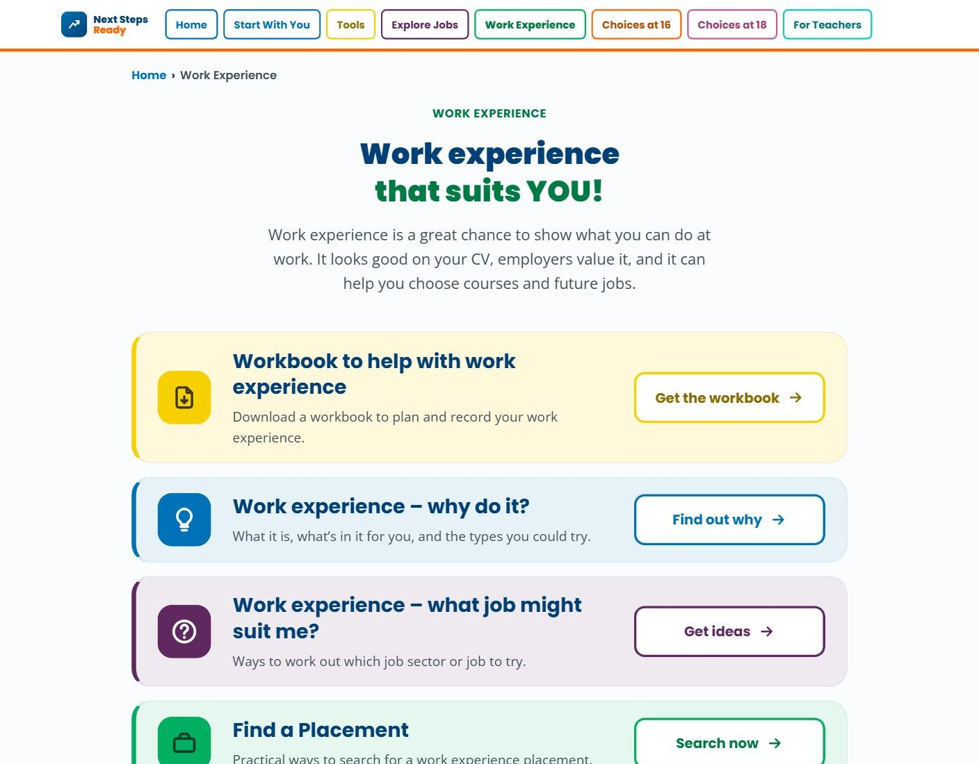


A website to help with your work experience
nextstepsready.org.uk
Free for everyone
No login or password
A whole section on work experience
Notes:
Introduce Next Steps Ready: a free careers website with no login, so students can use it in school and at home.
The Work Experience section (circled) helps students decide what job might suit them, search for a placement, contact an employer and record everything in a workbook.

Slide 17
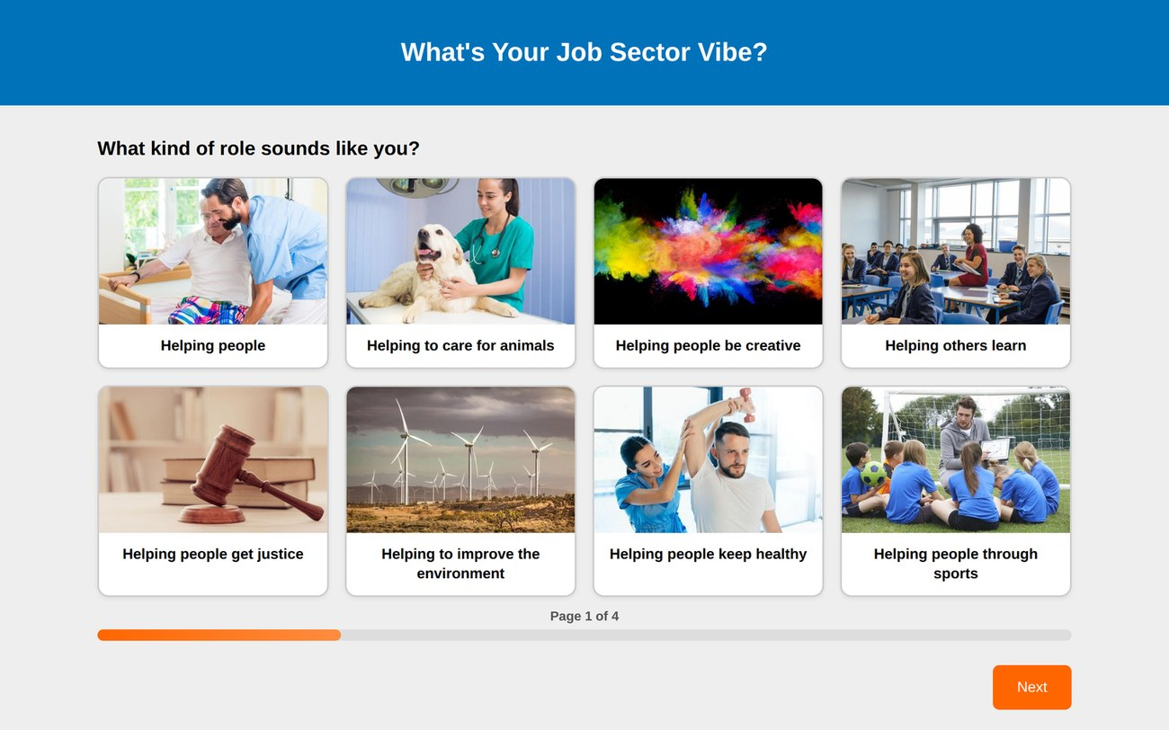
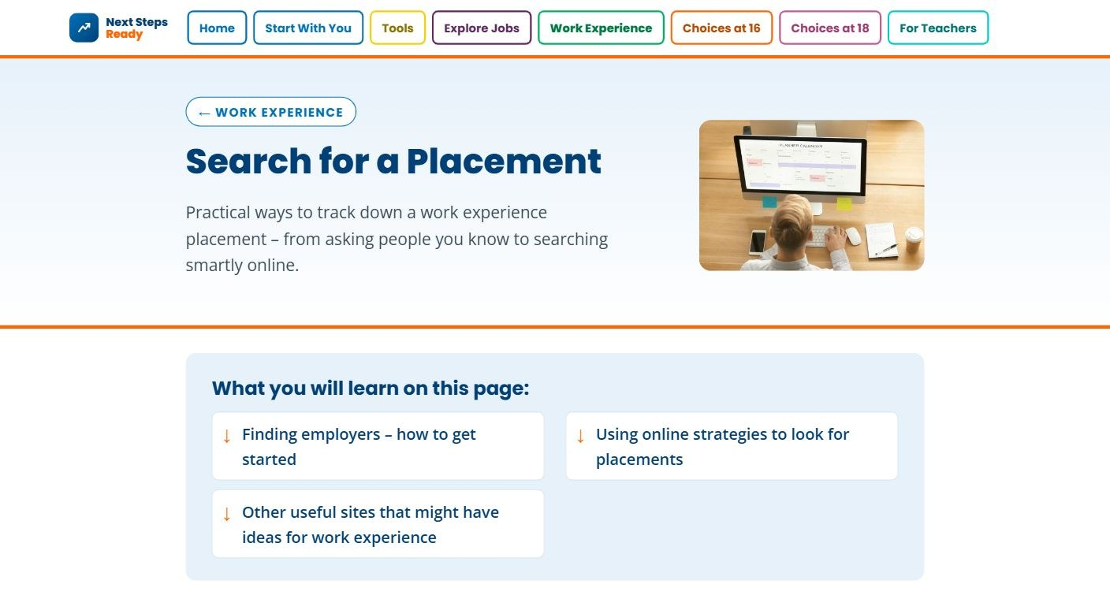
Task 1: Plan your work experience
1
Open "What job might suit me?" to choose job sectors
2
Do the Job Quiz to get ideas for jobs
3
Use "Find a Placement" for ways to find employers near you
Answer each question on your My Work Experience sheet – include local companies and how to contact them.
20 mins
Notes:
Students go to nextstepsready.org.uk and open Work Experience.
1. "Work experience – what job might suit me?" helps them choose the job sectors they would like to try.
2. They can do the Job Quiz to get ideas for jobs – there is a link in "What job might suit me?", or they can find it in Start With You.
3. "Find a Placement" gives practical ways to find employers, including searching online. Students can do a map search to see which workplaces are easy to get to, then look at the companies' websites for work experience information and contact details.
Students answer the questions on the My Work Experience sheet (slide 20): what they want to get from work experience, who could help, which job sectors interest them, and local companies they could contact.

Slide 18
Share your plan
10 mins
In pairs, share your plan for work experience: what you want to get from it, which job sectors you want to try, and local companies you want to contact.
Speak clearly and use facts and examples to explain your plan.
Listen carefully, then summarise what you heard to show your understanding.
Notes:
Students have 5–10 minutes to work in pairs to share their research and ideas.
This activity supports students to practise:
Step 8 Speaking – Using facts: I use facts and examples to support my communication
Step 8 Listening – Summarising: I summarise or rephrase what I learnt

Slide 19


In this lesson you:
Considered which learning pathway you could take at 16.
Found out how work experience can help you choose.
Started to plan your work experience.
Keep planning at home: nextstepsready.org.uk › Work Experience
Notes:
Recap the lesson. Ask: what is your next step to find a placement? Who will you ask?
Remind students they can use the Work Experience section of Next Steps Ready at home, including the workbook and the Contact an Employer template. In the next session they could build a CV (Work Experience › Build a CV).

Slide 20
My Work Experience
Name: ……………………………………………………………
What do I want to get from my work experience?
Who could help me find a placement?
☐ Try out a particular job
☐ Practise or learn skills
☐ Try out being a worker
☐ See whether the job I am thinking of is really for me
☐ My careers teacher
☐ My family
☐ My friends
☐ Other: …………………………………………
Job sectors I am interested in (e.g. hospitality)
……………………………………………………………………………………………………………………………………………
Local companies I could contact | Job sector | Contact details (website, email, phone)
Notes:
Printable sheet for Task 1. Print one copy per student.

